Slide 1
Prevention of Medical Errors
EyeMed 2025
Brian P. Den Beste,O.D.,F.A.A.O.
Diplomate ABO

Slide 2
Medical Error : defined
“A preventable adverse event”
Notes:
System deficiencies the complexity of medicine, vulnerable defense and human fallibility.

Slide 3
What is Medical Malpractice?
You just experienced a bad result. The corneal ulcer that you had been treating for the past month is now quiet but the patient’s best vision is now 20/50. ?malpractice?
The reality is a lot of lawsuits don’t have merit. A lot are due to a bad result, not bad doctoring.

Slide 4
Expect a marathon, not a sprint .
Malpractice suits are time-consuming and disruptive to your schedule, as 78% last more than a year, and 39% last more than three years.
But most cases will settle. In an analysis of 518 optometric cases, 98% were the result of negotiated settlements and only 2% the result of court judgments.
Review of Optometry.

Slide 5
Malpractice Insurance Policies and AI
Currently, malpractice policies do not specify AI coverage. “We don’t ask right now to list all the technology you’re using,” said Srivastava. Many EHR systems already incorporate AI. If a human provider is in the loop, already vetted and insured, “we should be okay when it comes to the risk of malpractice when doctors are using AI because it’s still the risk that we're ensuring,” she said.

Slide 6
Artificial intel.
“No one would sue you because you went to the library to look up information in the textbooks,” he said — using generative AI is similar. Try the free versions first; if you begin relying on it more, the paid versions have better features and are inexpensive.

Slide 7
Art. intel
Currently AI primarily used for what ?
Notes:
Transcribing clinical notes

Slide 8
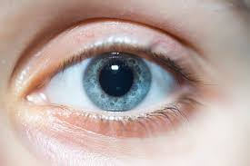
Dilate, dilate, dilate

Slide 9
Document, Document, Document
Especially if patient no shows for a follow up.
Corneal ulcers. Glaucoma. Disc edema (IIH) these are all serious conditions that require follow-up.
If you order imaging, you have to make sure they received it ,then you have to make sure you received the report.
The uninsured are a problem, we find them the least expensive CT or Mri and they still NS.

Slide 10
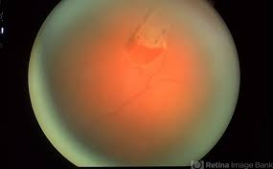
HS Tears, some patients are difficult and if they keep complaining get a consult

Slide 11
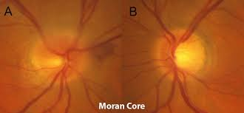
ION….TA,

Slide 12
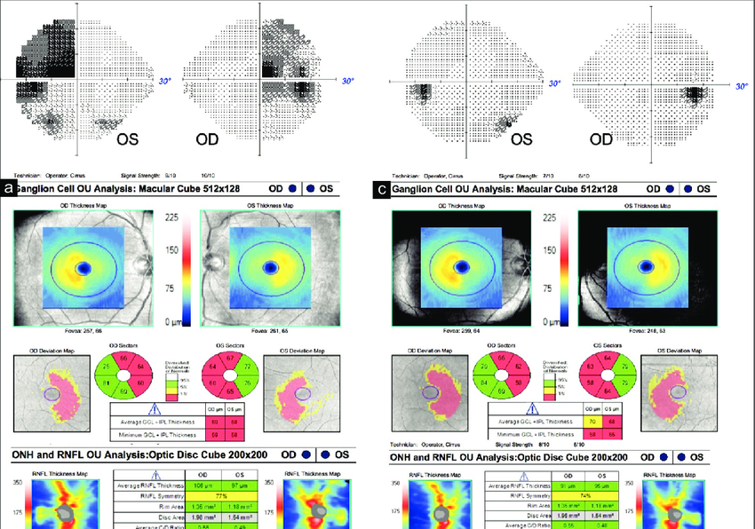
Notes:
Get Oct Vf can be difficult

Slide 13
Buy OCT

Slide 14
I just take photos
When patient is asymptomatic seems reasonable
Nothing takes place of 3-dimensional view.
When experts get into the picture….pardon the pun….dilation always prevails.

Slide 15
Tonometry
I –care
Puff
GAT
When technician has trouble or exam doesn’t add up or history of Glaucoma, you just can’t trust the first two. I have seen 20mm variation. Often they are close.

Slide 16
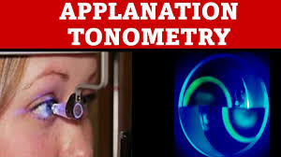

Slide 17
Is it open or closed?
PAS can happen when you don’t expect it.
Amazingly some angles appear open with Von Herrick and are not. Von Herrick doesn’t help with pigment depo or recession or PAS or….. Uveal tumor.
Lets vote : who likes 3 mirror and who likes 4 mirror. ? Why ?

Slide 18
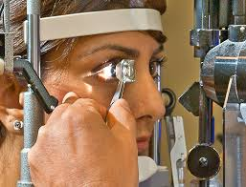

Slide 19
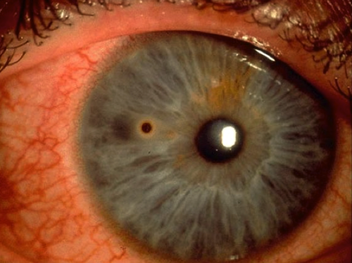
What if central…consent?

Slide 20
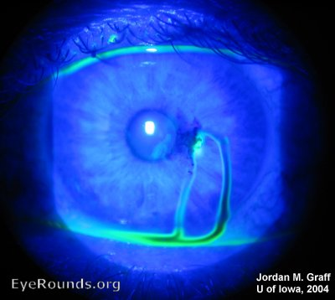
Don’t miss it

Slide 21
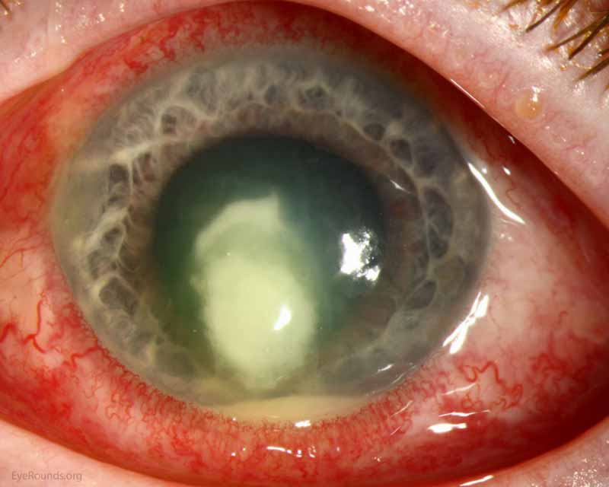
Fusarium: needs Cx and will have vision loss

Slide 22
Corneal ulcer/ inflammation
Ulcer and Hypopyon: std. is to culture
Central ulcers std. is to culture if size is 1.5 mm or greater
Is extended wear worth it?
Central ulcers: hold on the steroids, fungal ulcers are tricky and become trickier if steroids are added.

Slide 23
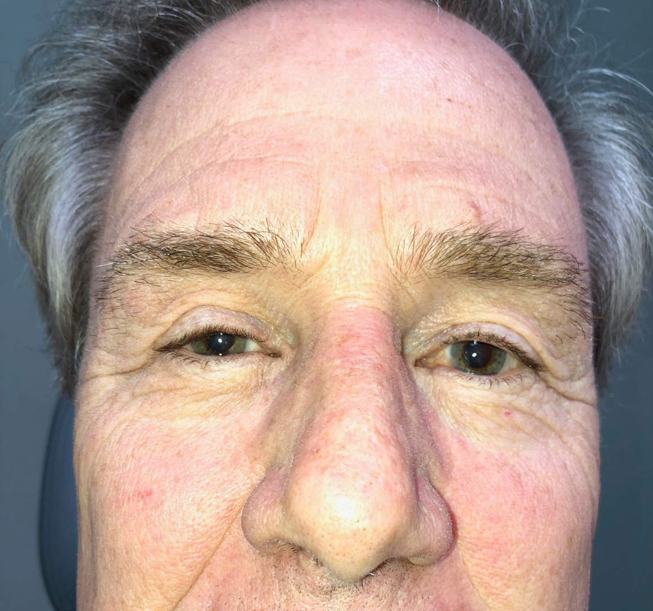
Occasional mucous in the am.

Slide 24
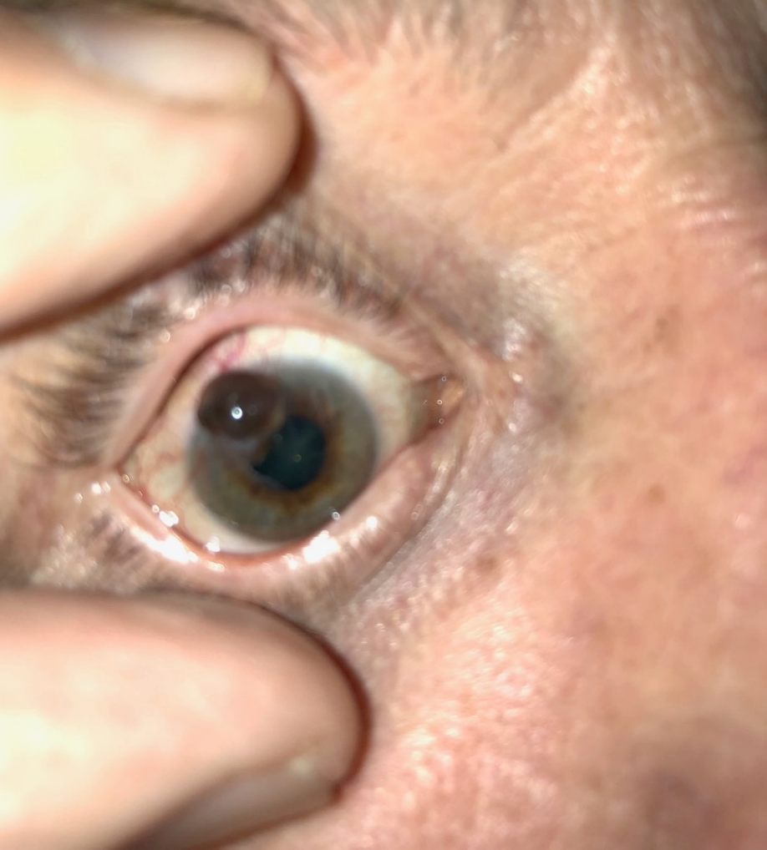
Corneal melanoma
Notes:
I couldn’t find it in the literature. Uveal melanoma 5 /1million. Conj. 10 % of the 5 so 1 in 2 million., similar to CB melanoma

Slide 25
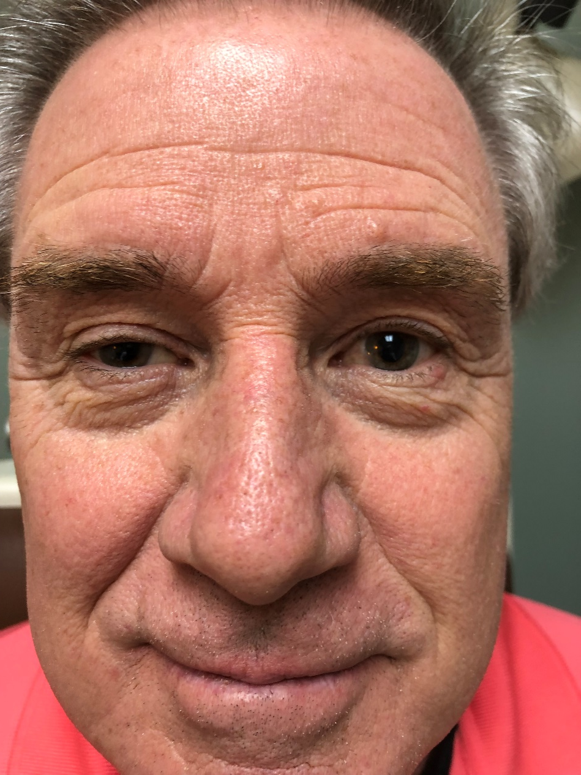

Slide 26
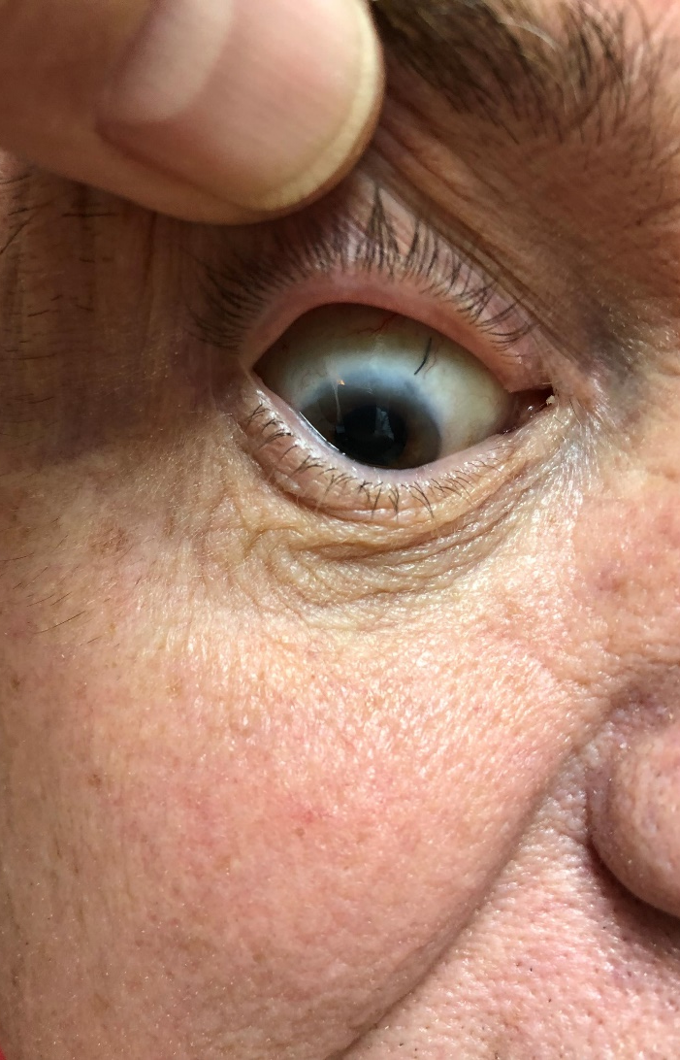
One yr later postop resection and radiation
Even more rare than Ciliary body Melanoma.
Uveal melanoma 5 /1 M
CB 1 /2M

Slide 27
More authority more exposure
Scope of practice, July 2024
1. Oral medication authority in all states
2. Glaucoma treatment, topical in all states
3. Oral steroid prescription authority in 42 states, not Fl. 1 of 8 states and of course DC
4. Injectables authority: anesth.,steroid and epi pen 25 states
5. Epi pen 18 states , includes FL
6. Laser authority (LPI, SLT, ALT, YAG Capsulotomy) 11 states
7. lumps and bumps surgery: 19 states
Make sure your carrier knows what you are doing

Slide 28
Florida generalities
We now live in a conservative state
The supreme court used to be quite liberal but that has changed overtime with two Republican Governors. Scott and DeSantis
Conservative states usually favor defendants and not injured plaintives
Summary judgements are more common here
Notes:
Summary judgements mean the judge can throw out the case if they don’t think enough evidents

Slide 29
Florida law
We do live in a state that is has favorable asset protection laws. “ Own a big house”
How about going bare….ie no mal- practice insurance?

Slide 30
Florida law
#3 in the nation with most med mal claims made. ( 2012-2022)

Slide 31
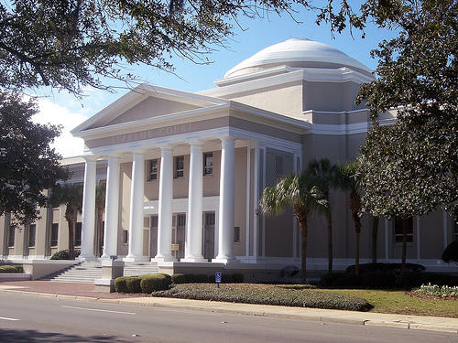
In Florida, there is no cap on non-economic damages for personal injury.
However, a cap has been established in medical malpractice (MedMal) cases. Governor Ron DeSantis signed a bill in March of 2023 to cap non-economic damages in MedMal cases at $500,000.
Never a cap on economic damages.
.
Notes:
In florida this may be reinstated

Slide 32
Florida in general
Top three settings for malpractice
1. Hospital inpatient
2. Hospital ERs
3. Doctors offices

Slide 33
Malpractice generalities
The standard of care is key ….you don’t have to be a super star….just average. What would a like practitioner do in a similar arena
It’s expensive to sue someone, the plaintive attorneys have to have pretty deep pockets …most cases are taken on contingency. Cheaper to go after slip and fall or motor vehicle cases…
But my friend who works for a state wide firm that defends Drs. says they are busier than ever

Slide 34
Malpractice generalities
People who are injured and sue: ask for compensation for medical expenses, loss of wages & pain and suffering.
They can also ask for punitive damages

Slide 35
What are punitive damages
To punish the Dr.
They would have to prove that the dr. had reckless disregard for the patient or that the Dr. purposely tried to injure the patient.

Slide 36
Age matters: harder to get lawyer to take your case
Sue for lost wages….less when you are older
So called Free Kill law …longstanding in Florida. Only state in USA that has this
If there is no surviving spouse or child under the age of 25 then the family is ineligible to collect damages from a wrongful death other than direct economic damages: usually drs. bills and funeral.
State Senator Clay Yarborough plans to file again this year. .

Slide 37
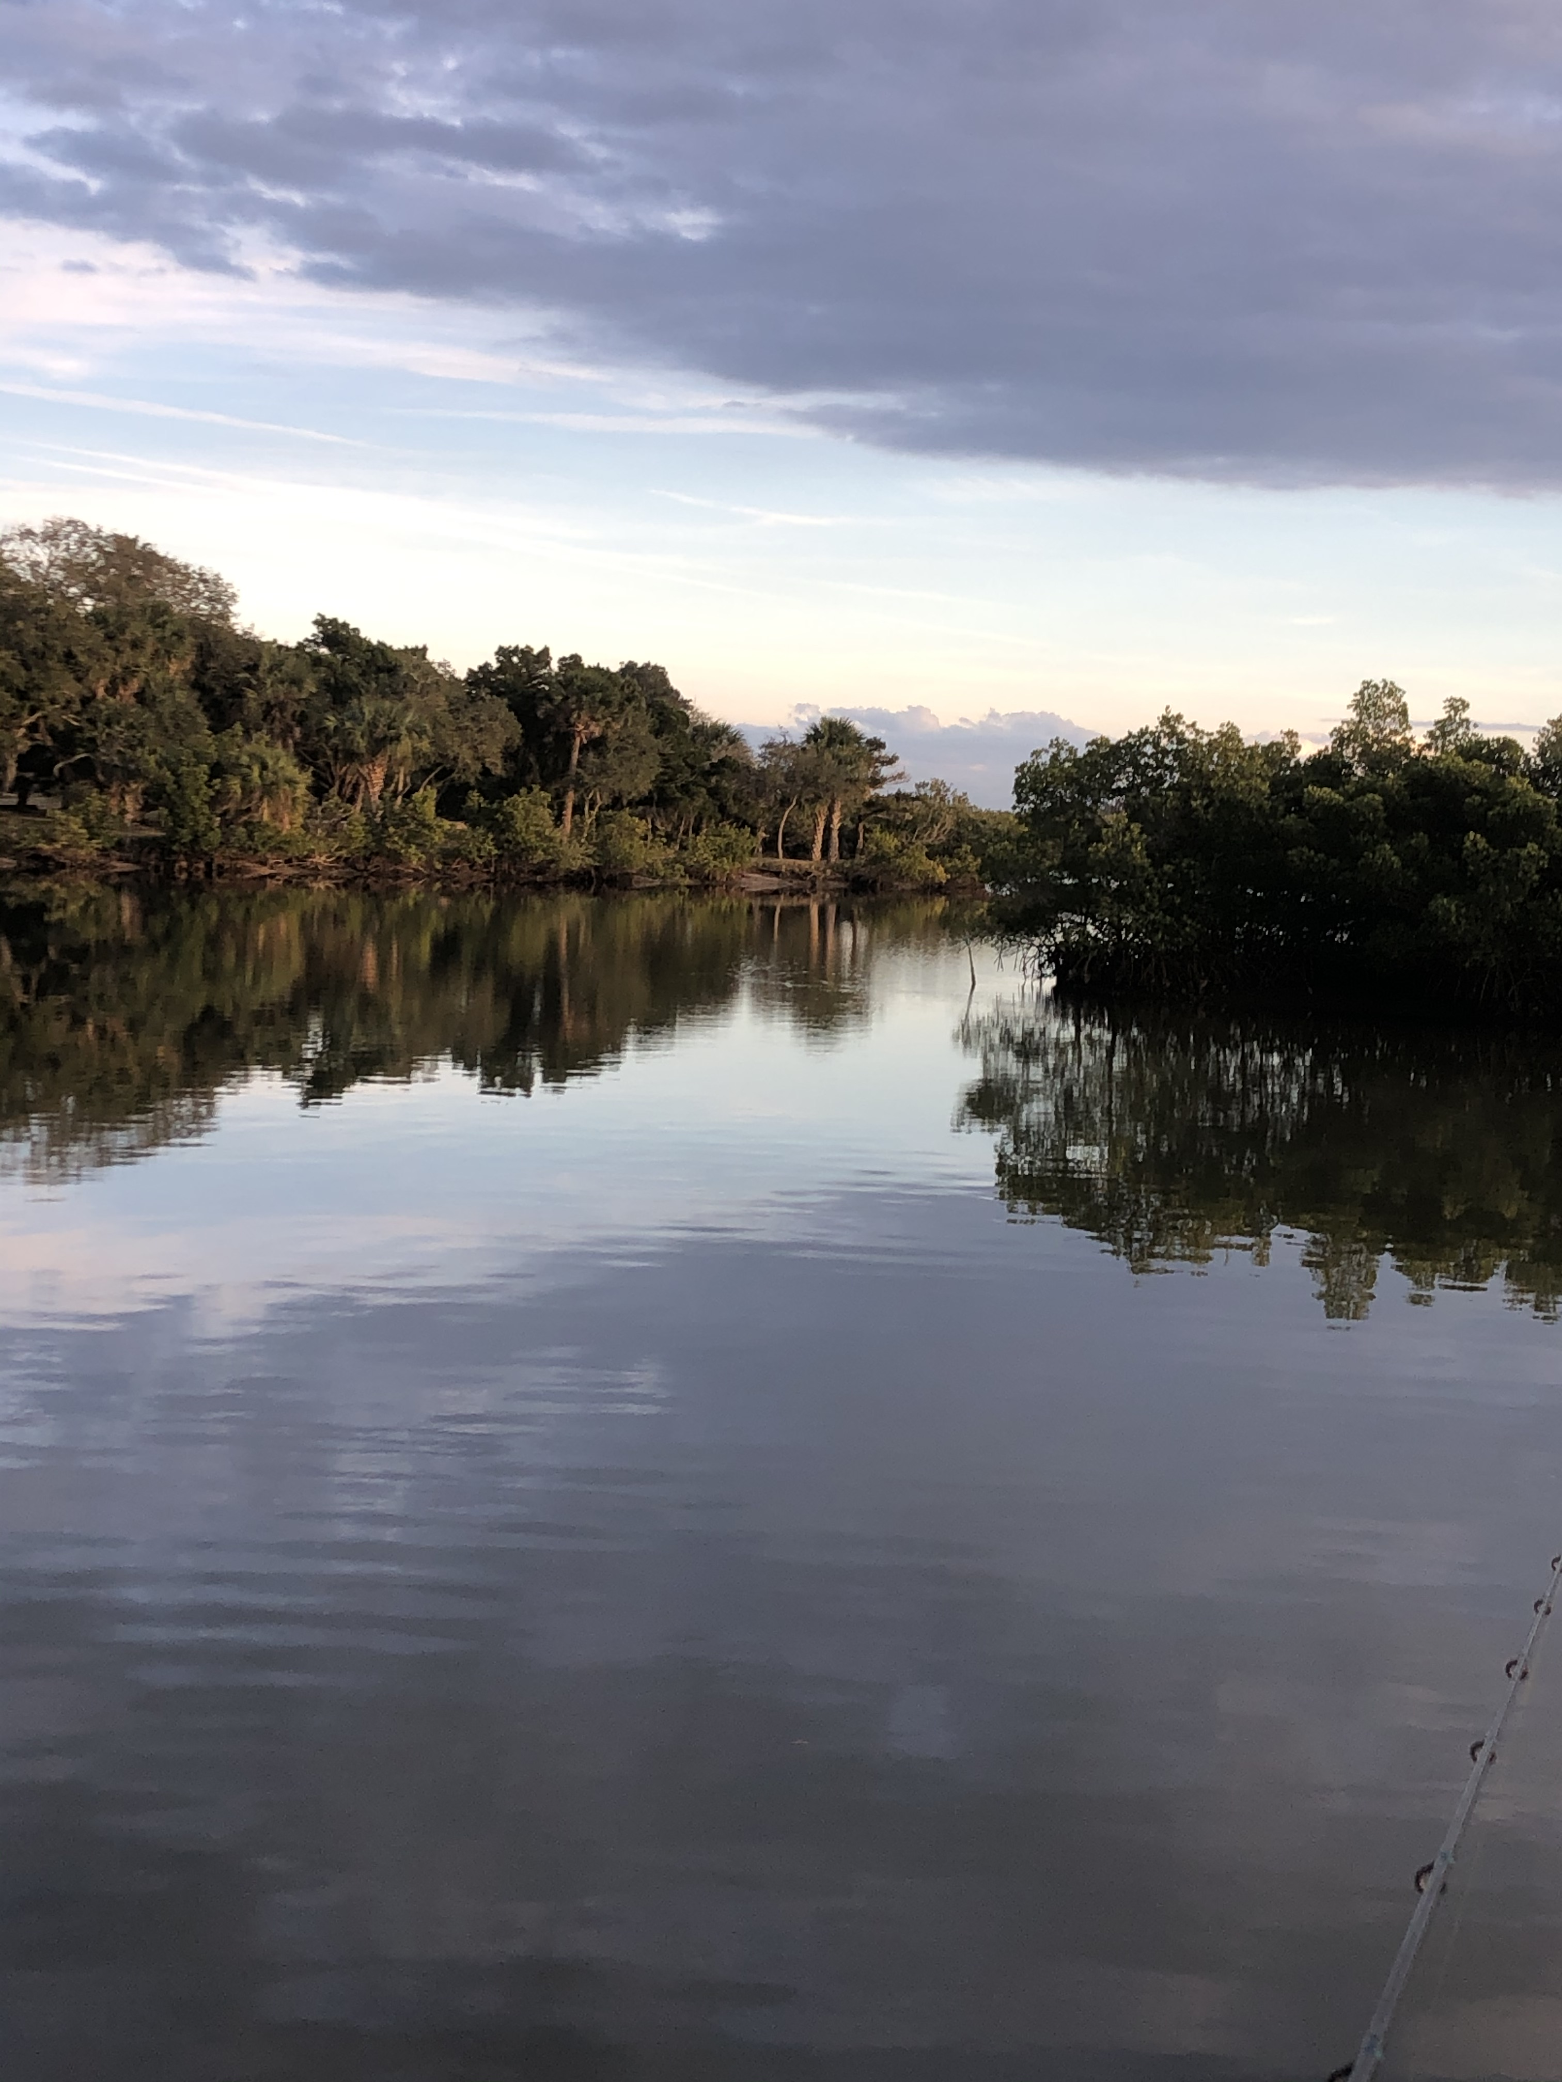

Slide 38
New England JOM
January 2017
Hospital medical errors are the 3rd leading cause of death in the US, behind Cardiovascular disease and Cancer…busted.

Slide 39
Medical errors
They are real but they are not the 3rd most common cause of death. Article written by Jonathan Jarry, M.Sc McGill newsletter Aug 2021.
Wrong dx, drug dosage errors, treatment delays are probably underestimated because these occur in clinics and not the hospitals where most of the studies are done.

Slide 40
McGill newsletter
Jonathon Jarry cont
The data that was used to say med errors are the 3rd leading cause of death came from extrapolation of data. One study was done in Colorado and Utah and the other study was done in New York
They took that data and applied it to all hospitals in the United States and concluded that between 44,000 and 98,000 people die each yr from medical errors.

Slide 41
Jonathon Jarry cont
The other study he sited was from the British journal of medicine and their extrapolation estimated that 400,000 deaths occur annually from medical errors performed in hospitals. That translates to nearly 66% of all deaths would be from medical errors
That is not credible. Others studies suggest a number closer to 3-4%

Slide 42
25% of hospitalized patients experience preventable medical errors…(not death)
Dr. Marty Makary, MD, MPH
Johns Hopkins school of Public Health. (Bottom Line, Jan 14 2013)

Slide 43
More Factors that Contribute
Highly complicated technologies
Fill in drs.
Language barriers…. Google translate !!
Too many patients?
Communication barriers between staff, and or patients.

Slide 44
17 Yr. Malpractice Data old slide but reiterates the %’s
9/1990 - 3/ 2008
MD 232,727
DO 14,733
Dentists 40,261
Podiatrists 6,618
OD 580

Slide 45
National practitioner data bank. NPDB
The website that you can access and other governing boards
Public can see data but not individual Drs
If you have an incident, your insurance will make a summary of the case and you should ask to see it before it is published.
You can add an addendum…” I didn’t want to settle but my insurance insisted”
Notes:
National practioner data bank.

Slide 46
Percentage of claims
National practitioner data bank
Diagnosis: lead cause for med errors
Diagnosis related 54%
Surgery related 18%
Anesthesia related 14%
Treatment related 4%
Obstetrics related 4%
Others 6%

Slide 47
EMR…a potential litigation issue
You must preserve your EMR: Back up back up
If you are sued and you don’t have the electronic chart you can be sued for spoliation of evidence, which can be worse than medical malpractice. It can result in what’s called “adverse inference”… which basically can switch the tables, where you have to prove you didn’t commit malpractice instead of the plaintiff having to prove that you did.

Slide 48
EMR challenges
Cookie cutter notes
Did you check the correct box
The optic nerve was pink and health…really??? and you are treating glaucoma.
15 % of time with patient , much more time with charting
Difficult to leaf back and forth from exam one to exam 10.
Drawings are not like the old days…often scan in my drawing
I still like EMR, no one can say you went back and altered a chart.

Slide 49
Root Cause Analysis (RCA)
The “whys technique”: A great tool to use in practice to determine why an error in patient care was made.
What happened, Why did it happen and what do you do to prevent it from happening again.
In a hospital setting it will involve multiple disciplines and has a strict requirement of impartiality

Slide 50
Medscape Mal Practice Report 2015
4,000 MDs were surveyed
OB- Gyns, Most likely to be sued
Psychiatrists and pediatricians least likely
Males 2 ½ times more likely to be sued than Females
85% of OBs, 83% general surgeons, 79% orthopods admit to being sued.

Slide 51
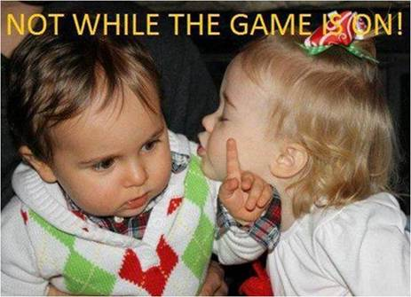
2 ½ times more likely

Slide 52
Law 101
You receive a letter from a plaintiff’s attorney saying they are intending to sue you, that means they have received your chart and have gotten another OD to sign a medical affidavit…….. Which means a like physician states that your care fell outside the std of care.
You then call your insurance co. and you are assigned an attorney and you have 90 days to respond
Notes:
Talk about will manual

Slide 53
Med Mal ( medical professional liability)
The usual cause of action for a suit is Negligence.
The plaintiff has the burden of proof to establish 4 elements for a finding of negligence:

Slide 54
The 4 Element of Proving Negligence
1. Legal duty is established
2. Breach of duty or breach of the standard of care.
3. Causation. The breach of duty caused the injury
4. Damages. The injury caused an actual damage.

Slide 55
1. Legal Duty Exists
This is typically established by the physician – Patient relationship. A chart was started.
This may occur even if you have never seen the patient! If you are giving advise to another Dr.’s patient that you are on call for.
A patient that you saw only once when your colleague went on vacation.
Your partner’s patient that you came in the room to see….for a moment
Notes:
Glaucoma patient that later sues your colleague hegland on call for tube

Slide 56
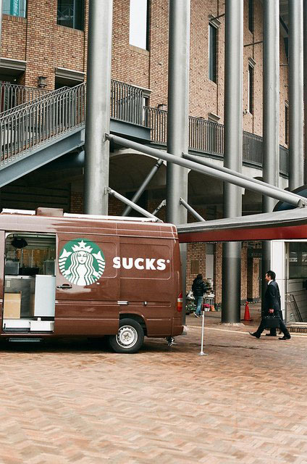

Slide 57
2. Breach of Duty
Once the legal duty is determined by the court or jury, the plaintiff must prove that a breach of duty has occurred, more commonly referred to as a deviation from the standard of care.

Slide 58
Standard of Care
It requires a physician to exercise the degree of knowledge and care ordinarily possessed and exercised by other members of the profession acting under similar conditions and circumstances.
AoA practice guidelines are useful
Will’s eye manual
Notes:
Could you culture an infectious ulcer at the homeless clinic?

Slide 59
Breach of duty
The breach may be a failure to diagnose…most common
Delay in diagnosis or delay in referral
Improper treatment
Failure to obtain informed consent
And/or substandard care
Notes:
Informed consent for EW scl?

Slide 60
To prove a breach std of care:
Expert witnesses are used
These are typically in the same specialty but don’t have to be, could be and Ophtho if they can prove they know what an OD std is ??
Notes:
Later case with the ciliary body melanoma

Slide 61
3. Causation
The plaintiff has to prove that your actions caused a problem…usually loss of vision or visual field. But could be loss of eye or even death
Notes:
Tumors intracranial

Slide 62
4. Damages
The fourth element the plaintiff must prove
“The corneal ulcer is causing the patient to not see”
Public Facebook or Instagram is fair game
Private investigators are used all the time, surveillance of malingering patient
The measure of damages is the amount that will compensate for the injury
Compensatory damages are divided into economic and non- economic damages.
Notes:
What if the patient wont wear rgp or under go a PKP Prvate investigators can only go to public places to see you

Slide 63
Economic Damages
Loss of wages… present and future
Medical expenses….past , present and future

Slide 64
Non-Economic Damages
Very subjective and can lead to a very large settlement
Pain
Physical impairment
Mental suffering, inconvenience
Loss of companionship, humiliation
Limited in California to 250K

Slide 65
In Florida, there is no cap on economic damages for personal injury.
However, a cap has been established in medical malpractice cases. Governor Ron DeSantis signed a bill in March of 2023 to cap non-economic damages in MedMal cases at $500,000. Physician and 750K for institutions.
.
.
Notes:
In florida this may be reinstated

Slide 66
Mega malpractice cases on the rise. Medscape 2/2024
$261 million Take care of Maya case in Fl. Johns Hopkins All Childrens hosp in St. Pete
2023 57 med mal verdict > 10 million and half of those were > 25 M.
New York, Illinois and Fl highest dollar amounts.
While most mega verdicts stick , still allows for higher settlements and makes ins.companies less likely to go to court.

Slide 67
Why are they on the rise?
People are angry at the healthcare system?
Heathcare has become big business…private equity owns large practices and hosp. Less personal relationship
Companies now invest in the litigation.
These large verdicts are causing large increases in Drs. premiums… in some states by 27%

Slide 68
Affirmative Defenses
1. Statute of limitations. Failure by the plaintiff to commence with action within the time limits set by the jurisdiction where the case is being brought. 2 yrs. in Fl. But this is the time from when the patient knew something was wrong….
2. Contributory or Comparative negligence: conduct by the plaintiff that falls below the std expected of a person for self- protection.

Slide 69
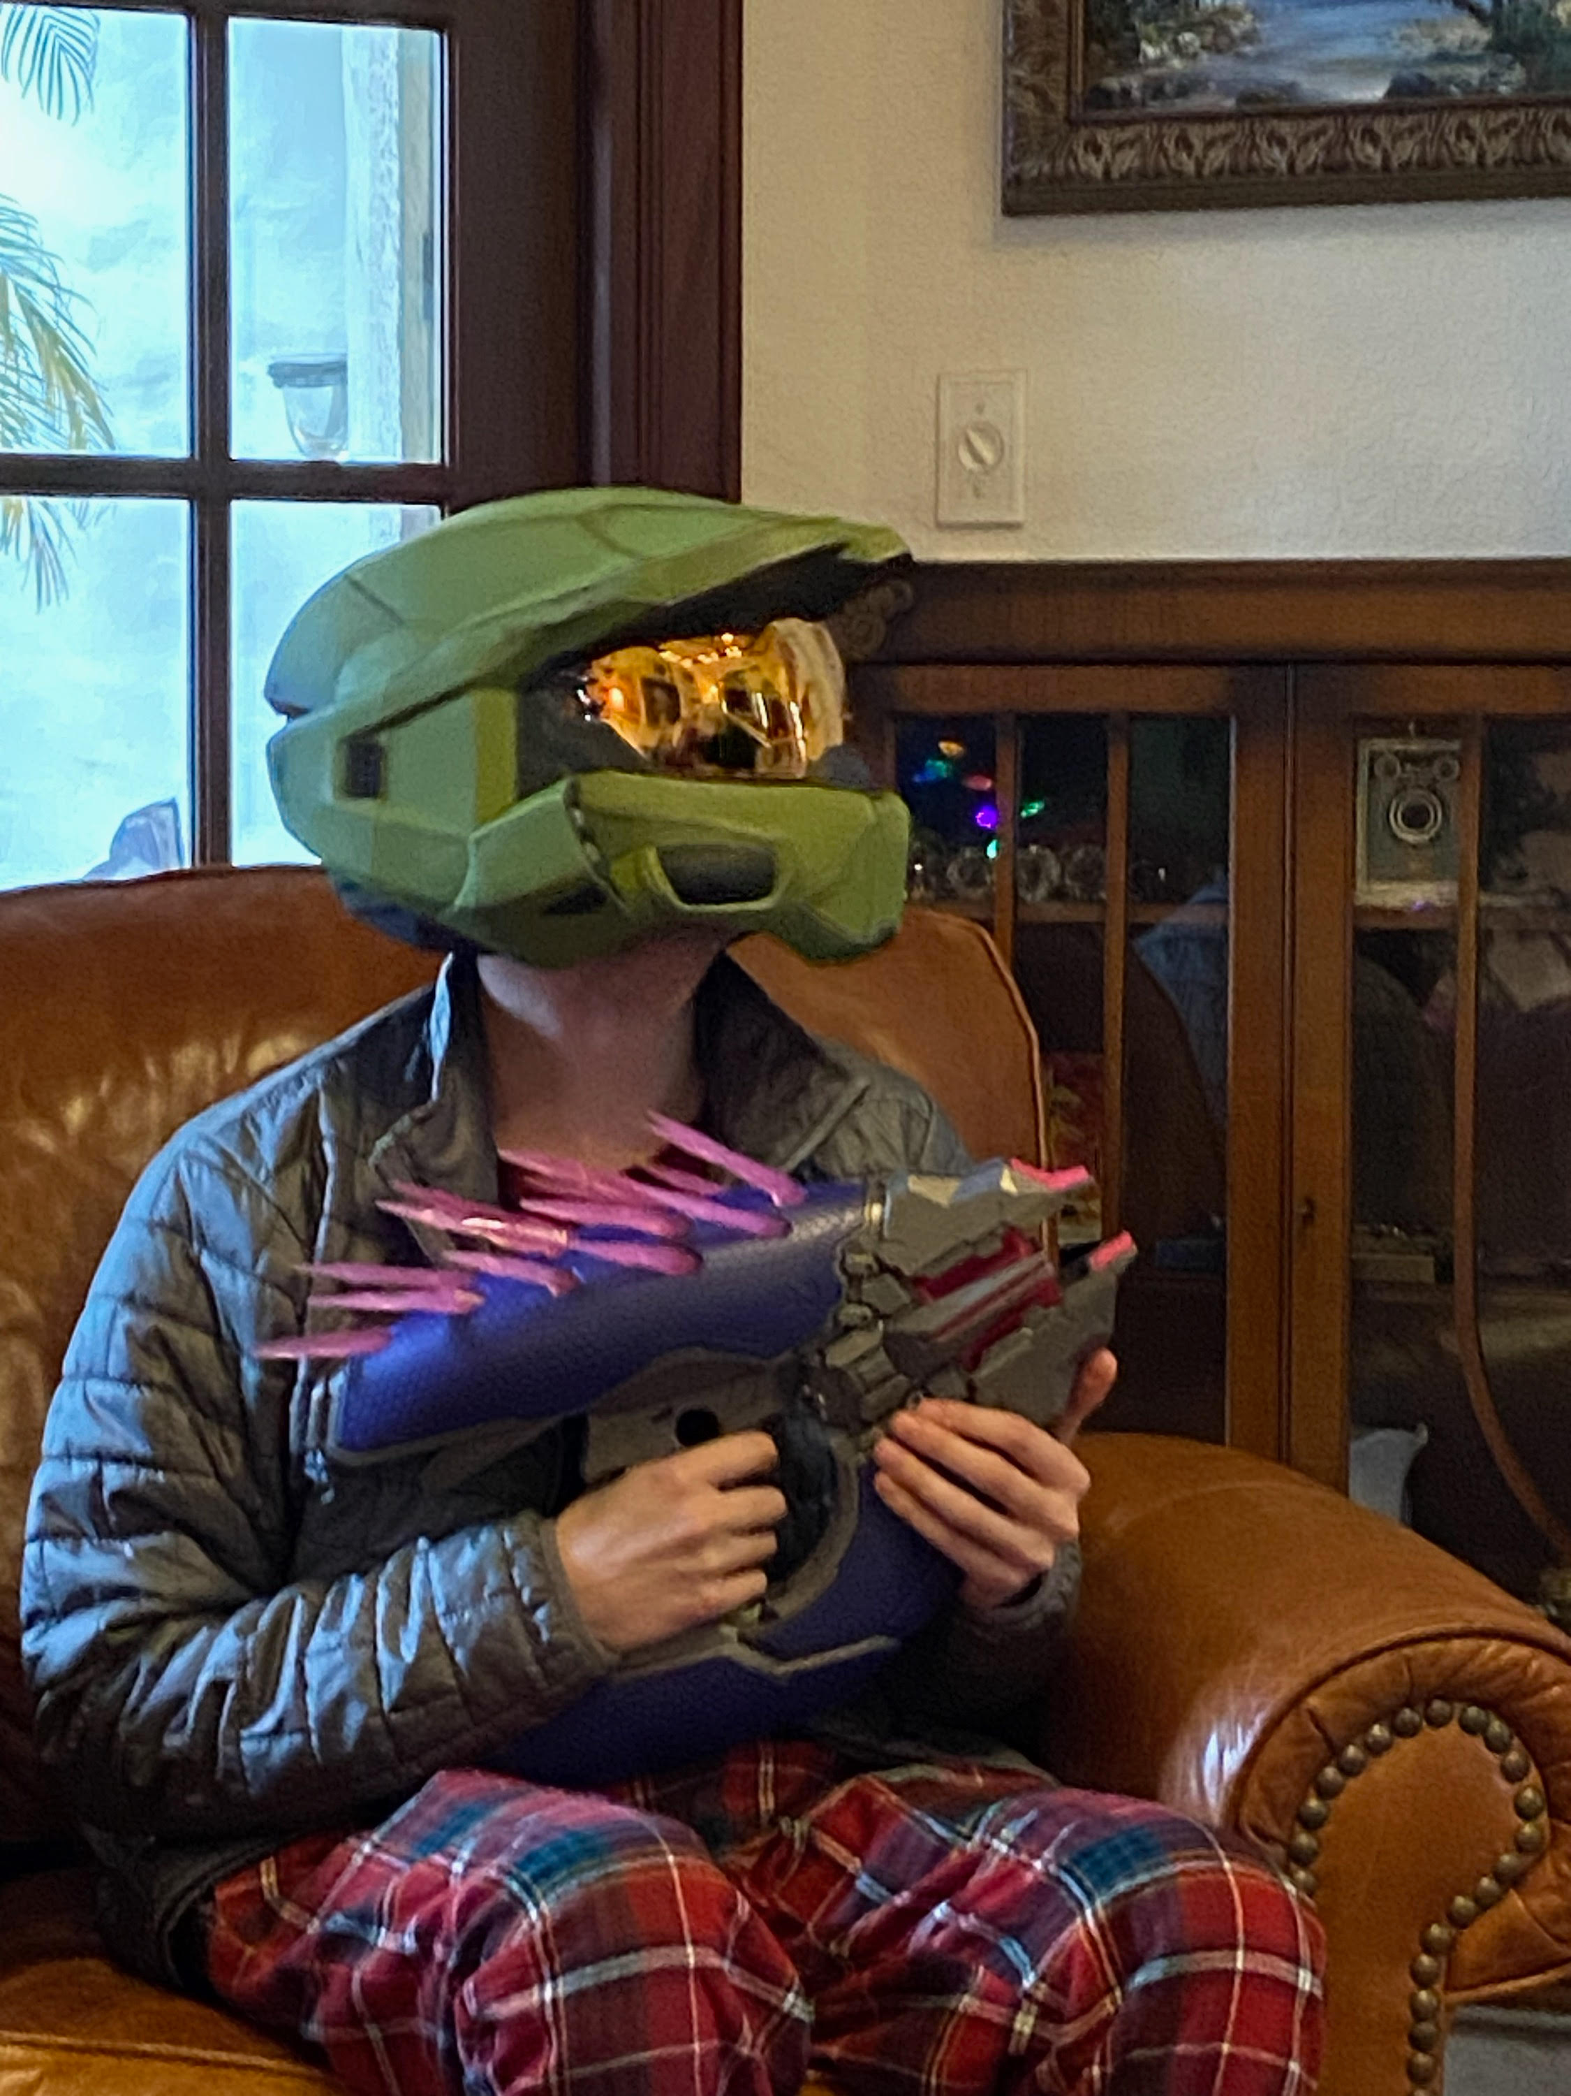

Slide 70
Risk Management Plan- incident report
Sore subject in Florida…they are discoverable !!!
Hospitals need to keep incident reports but ? Drs office. My friend didn’t think so in FL. 40yrs Mal Practice defense
So, I would not keep a separate file…. Just note in the chart the issues that occurred. Stick to the facts.

Slide 71
Communication is the Key
Poor communication leads to :
1.Diagnostic error
2.Noncompliance
3.Poor medical outcome
4. Increased likely hood of being sued
Good communication prevents the erosion in the Patient –DR . relationship
Notes:
Small pupil on oxycontin, did cat sx. Hisitory was of long standing loss of visiion.

Slide 72
Chair side manner
Every large city has a Dr. with more complications than anyone but a silver /glib tongue keeps them from being sued.
The skilled DR. with no charisma is more likely to be sued.
The patient that cries wolf often is annoying but can still have a new problem…. I have pain, I have floaters , “I can’t see” but read 20/25 after IOL and being -10 preop

Slide 73
Best Advise
Aaron Carroll report in NY Times. June 1 , 2015.
To be sued less, Doctors should consider talking to patients more. Patients do not like to be rushed or talked down to.
Make good notes, if you change a chart, date and note
Don’t let ego get in your way of making a referral

Slide 74
Damage Control
See patient regularly, don’t just click a tab on your EMR. I write notes as if something is going to go wrong and write to notes about what will be next if the current tx is not working.
Explain what happened. You have a rash because the medicine is a relative to the one you are allergic to.
Better to express concern show compassion and do not hurry the individual.
Return phone calls to patient and guardian promptly
If lawyer contacts you or patient leaves your practice avoid speaking to the parties involved…your lawyer or mal-practice carrier then takes over.

Slide 75
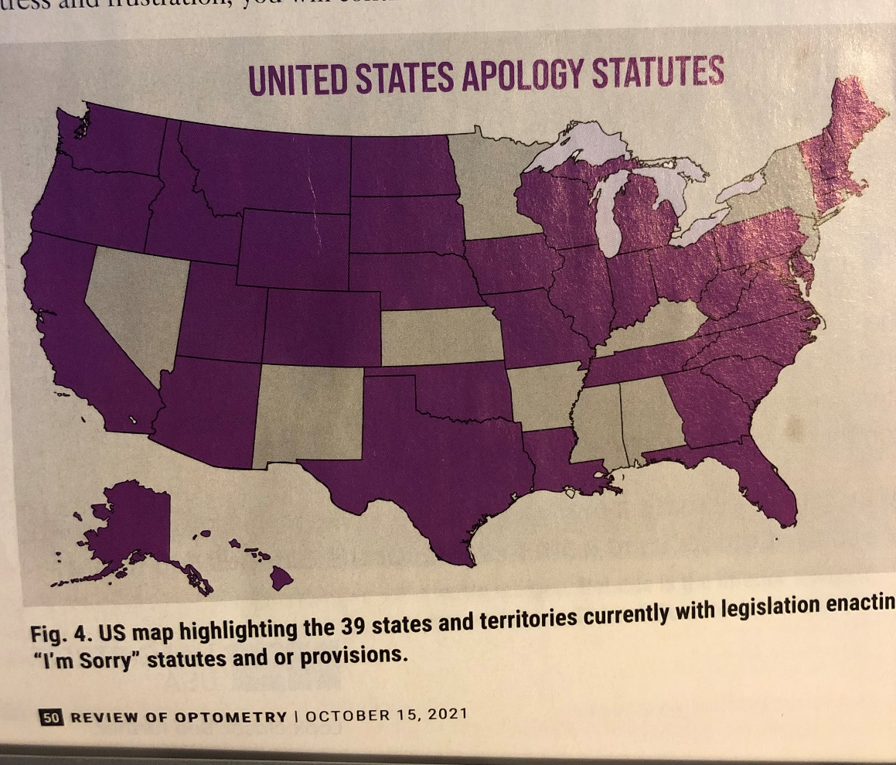
US apology states
Notes:
States that allow you to say your sorry and not be used in court if they sue. Sit down and explain outcome and express your that you feel bad that you had such an outcome, patients want to know that you care.

Slide 76
What to say to the Patient
Empathy is always good.
I wish your cornea would help us fight this terrible infection. The average time from onset to dx of Fungal keratitis is 2 months
I really hate what diabetes does to the retina
Tumors in the brain are sometimes hard to explain and are never easy to treat
Notes:
Quote eddie alfonso ….if the bug is not responding to your antibiotic it usually isn’t a bacteria

Slide 77
Mindful listening Means:
Carefully taking in what others say without judging them…..and this is difficult, but the hardest for me is when they won’t let you explain as they keep just keep talking and talking
Simply being Heard can solve Many Problems.
Empathy and Anger cannot Coexist

Slide 78
Body Language
Touch nose: disbelief
Rub neck: anger/frustration
Hands to lips: Impatience
Arms Crossed: defensive
Tug to ear: wanting to interrupt
Clenched fist: anger, tension
All limbs uncrossed : agreement

Slide 79
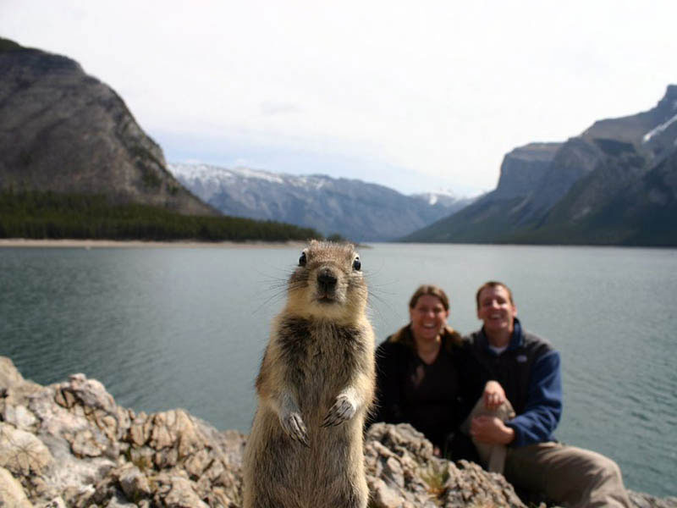

Slide 80
Medical Malpractice Exposure Assessment
After hour instructions for contacting me are available by calling my office number
I meet regularly with my front desk reminding them of conditions that need to be seen the next day
Remind students and technicians: “ I’m not aware of the specific concerns but I know Dr.__ will discuss everything with you when he/she examines you
Probably most important: Do not let charts get sent without your knowledge and prior review.

Slide 81
Hippa
Legislates that patients are entitled to a copy but nothing says it has to be immediate.
Once they sign a release then it can be sent
But only after you have reviewed. Within 30 days to avoid any issues with law.
I like to finalize charts within a few hrs of seeing the patient, but you can add addendums.
Notes:
Recent case about you girl with rupture globe.

Slide 82
Exposure check list
Patients with serious problems that are young or when there are language barriers… have someone with you preferably multiple people

Slide 83
Deposition
Be prepared
Have legal representation
Short answers, the plaintiff attorney, loves a conversation
Do not educate the plaintiff ( they may not know what to ask)
Do not argue
What is said in depo is what is used in court, you have a chance to read and revise.

Slide 84
Deposition
The problem with short answers : Can make the defendant look unintelligent , cold , not interested
The plaintiff goes first in a trial and they can can show how bad you are for 3 days before the defense has a chance to put the dr. on the stand. …. Jury already very tainted
Every case is different. But be prepared and ask questions during breaks of your attorney

Slide 85
Most common Mal Practice
The vast majority of optometric malpractice lawsuits, often stemming from a failure to diagnose, fall into one of these five categories:
1. Glaucoma #1 in terms of frequency
2. Retinal detachment (most common triage
issue)
3. Tumors ( more intracranial than intra-eye)
4. Anterior segment…CL 25%
5. Diabetic retinopathy
For me and cases I have reviewed – Peds.is Big.
Notes:
children tumor .. Amblyopia .largest payouts

Slide 86
Number 3 tumors, largest payouts
Vision not corrected to 20/20….Is this amblyopia? Vision shouldn’t worsen.
Have a reason for amblyopia…strab , aniso, injury
Pupils, may have to bring pt. back
Visual fields- attempt even if child or Haitian/non English speaking
Confrontations are good!

Slide 87
Vitreous Detachment
High myopes at greater risk
Presence of heme or pigment
3 mirror is useful in sometimes
Dilate both eyes
Consult if you are unsure about your technique, the view, the unruly or young patient
Speaking of vitreous, you should dilate AAU to rule out Vitritis: much more significant dis.

Slide 88
Sudden loss vs. gradual loss?
From a legal / litigious stance which is more problematic?

Slide 89
More Difficult?
From a litigious status , gradual loss is .
Following patient for cataract and Optic N. cupping gets forgotten or missed.
Following patient for glaucoma and OCT is miss-interpreted.
Open angle becomes chronic angle closure
Clinicians get “Chatty” with long time patients

Slide 90
Let’s discuss some cases.

Slide 91
Timely follow up, particularly one eyed patient
Patient presented for an emergency visit with complaints of new onset pain, acute loss of vision and onset light sensitivity of right eye which had been present for 2-3 weeks.
Taking 3 glauc meds. History of tube sx 1 yr prior
OD: 20/200 OS: NLP

Slide 92
Glauc pt.
Notes cells in the AC and diagnoses : primary uveitis.
Starts pred gtts and tells patient to return in…..drum roll…. 2 wks
Patient returns in 10 days with HM vision, hypopyon and endophthalmitis. (trabs are always at risk for this)
Settles out of court. 4 yrs later. ½ million

Slide 93
70 yr. old male who underwent glaucoma surgery with a Baerveldt tube.
Talked to by the OD on call, never saw the pt.
Surgery on Monday , seen on tues and given f/u visit for 2 wks.
Called on Thursday
Bloody tears on Cheek
Offered to see the patient but it was after hrs and not convenient for the patient

Slide 94
70 yr old
So kept his one week apt,
Hypopyon and HM vision
Patient was an accountant, called about bloody tears, but how do you wait to see the clinic when your vision is that bad?
MD was not sued., I like him but I didn’t like the guy on call
Settled right before going to court
Notes:
I think the radiologist missed the tumor, I hate my internist, I am going to sue him.

Slide 95
70 yr. cont
Lesson: enter info after an after hour conversations. His after hr conversations were written but not 1. entered into chart. 2.He was in the process of leaving the practice: negative lottery,
With that in mind: more than one problem can make something worse…floppy eyelid syndrome and postop endophthalmitis. Shield is more important for them.

Slide 96
80 yr old
Seen postop day one with blurred vision and pain
IOP not recorded….OD said he wouldn’t let her take the pressure
She told him to return in a week.
Seen a few days later by the MD with 20/400 vision and high IOP , APD and peripapillary hemes.

Slide 97
80 yr old
High IOP postop that resulted in Ischemic optic neuropathy vs CRAO
Had Tri moxi injection…. Dropless cataract sx
He had macular scar in his fellow eye.
the case against the OD was dismissed….”Having taken the IOP wouldn’t have changed the outcome.”

Slide 98
12 yr old white female
OD was being sued for failure to dx the patient’s glaucoma
Her chart goes back to when she was age 3
“Funny looking pupil”
Vision less than fellow eye and IOP sometimes higher on the NCT,

Slide 99
12 yr old
She over ruled the NCT IOP measurement on a couple of visits. Crossed it out !
Then the vision was getting worse correctable with more myopic rx
Then the optic nerve didn’t look the same
Referred but patient didn’t show
Parent took her to another dr and noted unilateral glaucoma, high IOP and high myopia

Slide 100
12 yr old
Glaucoma specialist said unilateral congenital glaucoma
She had ectropian uvea, which in some ways hurt the case as the iop was not always high as in congenital glaucoma, but helped the case because it is so rare, even the glaucoma specialist didn’t label the disease correctly.
Patient did not show up for visits when referred and I believe saved the case…it was settled out of court.

Slide 101
70 yr old male from Australia
Complained of blurred vision with his glasses in the left eye. Been to several ODs and all had trouble with his OS refraction
OD recorded VA of 20/20 in each eye, mild astigmatism, OS
Seen again in 6months, same complaints so referred to MD for Cataract sx., MD saw patient and discussed surgery and Multifocals and scheduled him for surgery

Slide 102






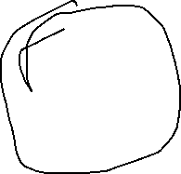
Ausi cont
Noted a lesion in the left retina and referred him to colleague, who then referred him to university. This is his drawing
Thoughts ?
Notes:
Ongoing case eye was removed MM, now has brain metastisis

Slide 103
Ausie
Ciliary body melanoma
Eye removed
Now with brain metastasis
? Malpractice
Expert is a academician MD
Notes:
Lesion not visible. , astig from the tumor. Less damage if dxd earlier? Able to save eye? Metss?

Slide 104
7 yr old Hispanic girl
Presents with lid edema, LLL
Mother says child opened the fridge and a bottle of soda fell and hit her head and eye
OD notes 20/50 vision and some lid swelling and a small heme/bruise on the lid and mild corneal edema
Dilated fundus normal
Told them to use cold compresses and return in 2 days

Slide 105
7 yr old cont.
She is feeling better and vision unchanged
Corneal edema and so patient is given rx for FML and told to return in 4 days to see his OD partner for full exam.

Slide 106
7 yr old
Patient feeling better but vision unchanged, didn’t fill Rx for steroid
Partner noted less lid edema and clearer cornea, told to not get gtts and return in a wk for full exam
She returned in a wk , edema resolved, refracted to 20/20 . DFE normal. Told to return in a yr.

Slide 107
7 yr old cont.
2 ½ months later , child’s eye noted to be drifting and Mother asks child about vision and says its grey.
Takes child to MD and noted to have complete funnel RD
Emergent sx at BPEI , but no reattachment
History obtained by MD was that the bottle dropped out of frig , causing the bottle cap to strike the child’s upper lid.

Slide 108
7yr old
The ultrasound showed indentation of the globe superiorly, and probable ruptured globe. Juvenile Vitreous to the wound, progressed causing complete detachment of retina

Slide 109
7yr old
This case was settled out of court for just under a million dollars. Civil suite
I reviewed it, after a settlement, the DOH attorneys get the document and sometimes then send to consultants to eval. Admin suite. I felt that the Drs met the std of care
But they didn’t finalize the chart and the front desk gave them a different chart than
What was later given… not the std of care.

Slide 110
Administrative law suite
Your malpractice policy usually covers you for legal help….10K but if it doesn’t you should still employ lawyer for help. If the DOH experts find probable cause then board of optometry can fine you and your license
In this case the plaintiff had no idea that the DOH was policing this case.

Slide 111
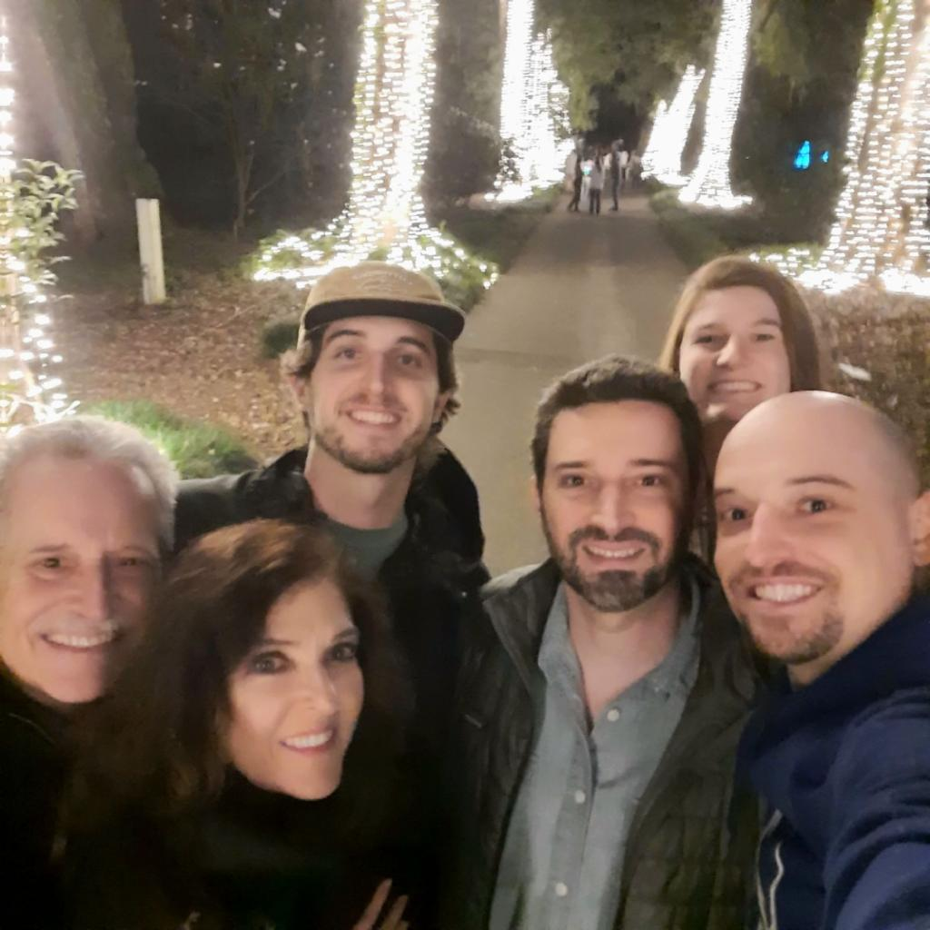

Slide 112
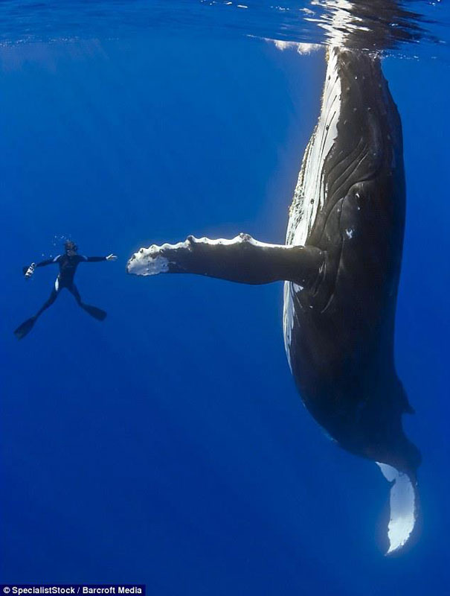

Slide 113
Questions
Briandenbest@gmail.com
321.331.6155

