Slide 1
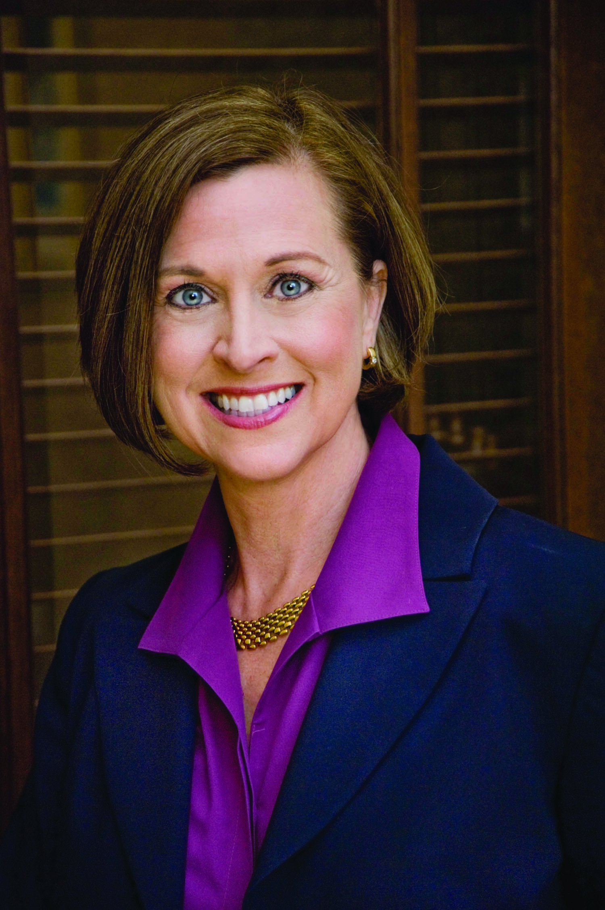
Florida Jurisprudence 2024
Alice Sterling, OD
2024

Slide 2

Florida Board of Optometry

Slide 3
Board of Optometry
David Rouse, OD - Chair 6/15/2018-10/31/2025
Katie Gilbert Spears, OD, JD 10/31/2019-10/31/2026
Denise Burns-Legros 10/31/2019-10/31/2027
Robert Easton, OD 10/31/2022-10/31/2025
Bryan Stam, OD 4/30/2024- 10/31/2027
John Griffin, JD 10/31/2018 – 10/31/2026
Kevin Rollin, JD 10/31/2017 – 10/31/2025

Slide 4
Mission Statement
The sole legislative purpose in enacting this chapter is to ensure that every person engaged in the practice of optometry in this state meets the minimum requirements for safe practice. It is the legislative intent that such persons who fall below minimum standards or who otherwise present a danger to the public shall be prohibited from practicing in this state

Slide 5
Florida Optometric Association Board
Mission Statement: To advance and promote the quality, availability and accessibility of primary eye and related health care of Florida’s citizens; to represent the profession of optometry; to enhance and promote the independent and ethical decision-making of its member; and to enable optometric physicians to practice at the highest standards of patient care.

Slide 6
FOA Board
Steven Silverstone, O.D. – President
Nathan Etten, O.D. - President Elect
Susan Beck,, O.D. – Vice President
Greg Naberhaus, O.D. – Secretary Treasurer
Chris Williamson, O.D. – Senior Trustee
Hang Thai, O.D. – Trustee
Smith Blanc, O.D. – Trustee
Susan Summerton, O.D. - Trustee
Peter Santisi, O.D. – Chairman of the Board

Slide 7
Florida Statutes
“The Laws”
463 – Optometry Practice Act
456 - Health Professions and Occupations
408 - Health Care Administration
120 - Administrative Procedure Act
119 - Public Record
112 - Public Officers and Employees
465 - Pharmacy

Slide 8
Florida Administrative Codes “The Rules”
64B-13
Controlled by ruling of the Board of Optometry
AND a bunch of legal people

Slide 9
Website Resources
www.floridasoptometry.gov
www.flrules.org
www.floridaeyes.gov

Slide 10
Division of Medical Quality Assurance
MQA works in conjunction with 22 Boards and 6 councils to license and regulate 7 types of health care facilities and more than 200 license types in over 40 professions.
MQA has 3 bureaus:
Health Care Practioner Regulation
Enforcement
Operations
Key Processes:
Licensure
Enforcement
Information
A

Slide 11
Board Responsibilities
Approving or denying licensure applicants
Reviewing and approving continuing education courses and providers
Promulgating administrative rules authorized by statute
Determining probable cause
Disciplining licensees found to be in violation of applicable laws

Slide 12
Board Responsibilities
The Board is a governmental regulatory body responsible for protecting the healthy and safety of the public and enforces the laws regarding professional practice.
The Board adopts rules and policies that establish minimum regulatory standards for safe practice and clarifies the Practice Act.
Takes disciplinary action in response to violations of the Practice Act and associated rules. The Board cannot independently change Florida Statutes.
The Board does not take any disciplinary action without an investigation of all facts involved. Licensees are entitled to a hearing and may hire an attorney to represent them.
The Board does not make or change regulations in secret; it is a public process that includes public meetings.

Slide 13
The Sunshine Law & Public Records
286.011 and 286.012 Florida Statutes: All meetings of any Board at which official acts are to be taken are public meetings. Attendance at meetings held in violation of the Sunshine Law can be subject to fines and/or criminal charges.
Voting: All members of the board present at the meeting must vote on each decision. Three exceptions: Conflict of interest, bias or prejudice, probable cause member.
Scope of Sunshine Law: The Sunshine Law is applicable to any gathering where the members deal with any matter on which foreseeable action will be taken by the board.

Slide 14
Latest News
Will there be more on-line options?
Is the emergency rule a test to see if online CE will expand?
Electronic Prescribing Requirements
Human Trafficking
Nonopioid Alternatives Pamphlet
Telehealth
Endorsement/Reciprocity
Fingerprinting
Non Compete
New license category

Slide 15
Unlicensed Activity (ULA)
MQA is charged with stopping unlicensed activity.
Those individuals who perform regulated health care activities without the proper licensing in FL are usually committing a felony-level crime. When practitioners pay their licensing fees, $5 is designated specifically to combat unlicensed activity.
The Board does not review unlicensed activity cases.

Slide 16
Impairment Programs – 456.076 F.S.
Treatment programs for impaired practitioners, sets for the requirement for the DOH to designate an impaired practitioner program that will:
Work with the DOH in intervention
Set requirements for evaluating and treating a professional
Establish requirements for continued care of impaired practitioners
by approved treatment providers
Require continued monitoring by the consultant of the provided care
Uphold requirements related to the consultant’s expulsion of
professionals from the program
The DOH has contracted with the Professional Resource Network (PRN)

Slide 17
Finding the Answers You Need
Websites
Subscribe for updates on e-mail
Department of Health Staff
Board Members
Past Board Members
FOA/legal
Declaratory Statements
Remember Government in the Sunshine

Slide 18
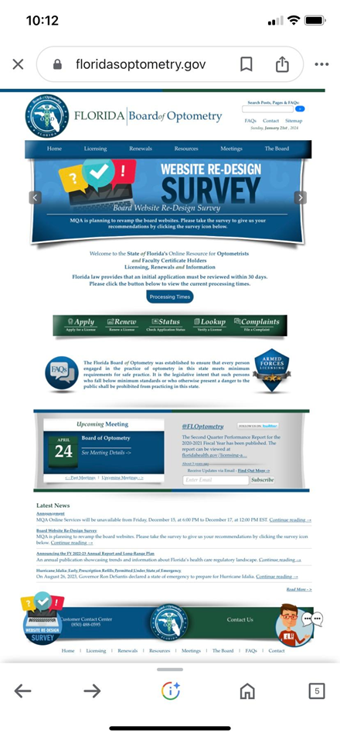

Slide 19
Department of Health Staff
Dale DeCastro Mooney Executive Director
Donatavia Wilson Program Operation
Kelly Woodward Supervisor/Consultant
Evelee Taylor Regulatory Specialist
Nicole Wiley Regulatory Specialist
Ashley Stelly Regulatory Specialist
Richard Hudson Regulatory Specialist
Karen Miller Administrative Assistant
Keri Kilgore Continuing Education

Slide 20
2023 Board of Optometry Meetings
February 10 Phone conference
May 12 Phone conference
August 11 Phone conference
October 20 Phone conference

Slide 21
2024 Board of Optometry Meetings
January 5 Phone Conference
April 24 Phone Conference
May 22 Phone Conference
July 17 Phone Conference
August 6 Phone Conference
October 25 Phone Conference

Slide 22
2025 Board of Optometry Meetings
January 24
April 11
July 16
October 24

Slide 23
Topics from January 5th Meeting/phone
New rule: 64B13-4.010: New limited license category
Discussion of 7 categories of optometry licensing
Telehealth guidelines
Proposed legislative action- Criminal background checks
Approval of 199 new licenses

Slide 24
Healthcare Complaint Portal
The FL Dept. of Health’s Division of MQA recently launched a new health care complaint portal.. The portal allows more convenient reporting of everything from unlicensed activity and health care violations, to fraud and more. It provides education on which state or federal agency to contact for a variety of issues ranging from HIPPA violations to independent living facilities.
To visit the portal and to file a complaint, visit:
www.flhealthcomplaint.gov

Slide 25
Complaints and Enforcement
The Consumer Services Unit (CSU) is where the process starts. It is the central intake for all complaints including unlicensed activities. CSU includes investigators and analysts assigned to specific professions. Staff reviews each complaint for possible violations of the laws and rules. Complaints are assigned a computer generated number for tracking purposes.

Slide 26
Legal Sufficiency
If the allegations and supporting documentation show that a violation may have occurred, the complaint is legally sufficient for investigation. The complainant is notified by letter if: 1) an investigation is being initiated, 2) additional information is needed, 3) the complaint is not legally sufficient.

Slide 27
Examples of complaints that may be investigated
Practicing below minimum standards or negligence
Impairment/medical condition
Advertising violation
Sexual misconduct with a patient
Misfilled/mislabeled prescription
Failure to release patient records

Slide 28
Examples of complaints that may not be investigated
Fee disputes
Billing disputes
Personality conflicts
Bedside manner or rudeness

Slide 29
Investigative Service Unit (ISU)
ISU is the investigative arm of the division. They investigate licensed and unlicensed persons referred from CSU. A staff of professional investigators collect documents and evidence and prepare reports for the Prosecution Services Unit.

Slide 30
Investigative Steps
Obtaining medical records, documentation and evidence related to the complaint.
Locating and interviewing the complainant, the patient, the subject and any witnesses.
Drafting and serving subpoenas for necessary information.
Compiling a report that will be forwarded to the department’s attorneys for legal review.

Slide 31
Prosecution Services Unit
Attorneys review the investigative report to recommend a course of action that may include:
Emergency Order
Expert Review
Closing Order
Administrative Complaint

Slide 32
Probable Cause Panel
Comprised of 2-3 board members (Can be past board member and consumer member)
Closing Order: Case dismissed if expert opinion does not support the allegations. (Does not become public record)
Administrative Complaint: Panel decides the allegations are supported (Becomes public record)

Slide 33
Administrative Complaint Options
Disputed issues are argued before the Division of Administrative Hearings
Stipulation Agreement
Hearing before the board to present mitigating factors
Voluntary relinquishing of license

Slide 34
Common Citations
CSU has the authority to issue without going through the entire process:
Advertising
Continuing Education

Slide 35
Common Complaints
Common but not investigated: Disgruntled patients due to fees/charges or personality conflicts
Common investigated charges: Improper record keeping, inappropriate conduct, scope of practice
Common but not enough evidence to move forward: illegal commercial leases

Slide 36
No one is protecting you but you!
Ignorance is not a defense
Licensee is responsible for knowing the laws and rules
Review 456, 463, and 64B-13 every year:
Chapter outlines make it easy to find
64B-13 changes more than the Statutes

Slide 37
New Legislation Impacting Optometry
HB 21 – Controlled Substances – Effective July 1, 2018
456.0301 F.S. – Requires practitioners to complete a specified board approved CE course to prescribe controlled substances. The bill defines “acute pain” and establishes prescribing guidelines and grounds for disciplinary action if not followed. It limits opioid prescriptions for the Tx of acute pain to a specified time period and requires HCPs to check the prescription drug monitoring program (PDMP) database prior to prescribing or dispensing controlled substances.

Slide 38
New Legislation (cont’d)
All licensed and certified optometrists who registered with the DEA and are authorized to administer and prescribe are impacted by the changes in the Controlled Substance Bill. There are four key changes in the law for all certified optometrists.

Slide 39
New Legislation (cont’d)
A Certified optometrist must take a Board approved 2 hour CE course on prescribing controlled substances
Prescription supply limits for the treatment of acute pain that may not exceed 3 days or up to a 7 day supply in special circumstances.
The FL Board of Optometry will develop guidelines for prescribing controlled substances for acute pain
Certified optometrists will be required to utilize the PDMP for the prescribing or dispensing of controlled substances.

Slide 40
More HB 21
Online CE approved as part of the statute
  Must complete prior to January 31, 2019
  Available on CEBroker
Rulemaking
  Disciplinary consequences to be determined
  Where the 2 hours fit into the 30 hours
  Possibly a requirement for non DEA ODs

Slide 41
As part of the 30 hours, all certified ODs registered with DEA shall, and all licensed ODs may, complete a board approved 2 hour course on prescribing controlled substances. All certified ODs registered with DEA must complete the course by 1/31/2019, and during each subsequent licensure renewal biennium. For all licensees, the course may be completed in either a live or online format

Slide 42
Online CE Courses
Controlled Substance – 2 hours – only available online. Will be permitted as 2 hours of the 30
Practice Management - 2 hours will be allowed as online credit as part of the 30 hour requirement
Oral Ocular Drug Certification- 20 hours approved online as part of the 30 hour requirement.
Human Trafficking is required for new licensees and is available online. However, it is not counted as CE since there is no optometric specific education involved.

Slide 43
Emergency On-Line CE Rule
Allows for virtual-live interactive synchronous online CE credit.
Only allowed for December 1, 2020 through February 28, 2021
Course providers must confirm attendees are visible for the entire course.
TQ courses must have the capability of being submitted and graded electronically.

Slide 44
You Should Already Be Aware
F.S. 456 Health care fraud
F.S. 483 Clinical laboratories
F.S. 463 Oral Drugs
Adverse events
Boxing
64B-13 Initial State licensing
Dispensing optometrist
Fees

Slide 45
Prescription Drug Importation Programs
The law establishes 2 programs to safely import FDA approved prescription drugs into FL: the Canadian Importation Program and the International Drug Importation Program. The Department is responsible for the creation of and inspection of new permits for an international export pharmacy. The law creates eligibility criteria for the types of prescription drugs to be imported, the importation process, safety standards, distribution requirements and penalties for violations of the established program. Federal approval is required before the programs may begin.

Slide 46
Chapter 2016-240
House Bill 7087 passed and became law on 4/14/2016. This bill creates the Telehealth Advisory Council and also requires AHCA, DOH and OIR to survey healthcare facilities, healthcare practitioners, insurers, and HMOs regarding the use of telehealth in FL. The Telehealth Advisory Council is tasked with reviewing the survey and research findings and making recommendations to increase the use and accessibility of telehealth in FL

Slide 47
2016-240 continued
Effective July 1, 2016, DOH will survey all health care practitioners, as defined by 456.001, F.S., upon and as a condition of renewal. The telehealth survey conducted by DOH during licensure renewal is required, and the DOH may assess fines for non-compliance with the survey request.
AHCA has launched a dedicated webpage for House Bill 7087. It includes information, FAQs, links, resources and surveys. www.ahca.myflorida.com/SCHS/telehealth

Slide 48
Telehealth: July 1, 2019
Creates section 456.47, F.S. establishing standards of practice for telehealth providers, registration of out-of-state providers, venue requirements and exemptions. Additionally, effective July 1, 2020, the Department shall annually review the amount of any fees collected under section 456.47, F.S. to determine whether such fees are sufficient for the Department or Board to implement the section.

Slide 49
Telehealth Licensing
The out of state telehealth provider registration is for health care practitioners licensed outside of FL only. Florida licensees can already provide telehealth services to patients in FL that they can treat in person.

Slide 50
Out of State Telehealth Providers
Submit Application
Must have unencumbered license from another state
No pending investigations for 5 years
Maintain liability coverage equal to FL doctors
Not open an office in FL for in person care
Only use FL licensed pharmacy

Slide 51
Nonopioid Alternatives: 7/1/2019
Creates section 456.44 (), F.S., requiring the Department to develop and publish on its website an education pamphlet regarding the use of nonopioid alternative for the treatment of pain.
Prior to ordering Schedule II drugs, the law requires the discussion of non-opioid alternatives with the patient and dispensing of the pamphlet “Alternatives to Opioids”
The law does not apply to emergency situations.

Slide 52
Alternative Treatment Options for Veterans
Creates section 295.156, F.S. that requires alternative treatment services for veterans who have been certified by the Dept of Veteran Affairs as having TBI and PTSD to be provided under the direction and supervision of a licensed physician, osteopathic physician, chiropractic physician, nurse, psychologist, or a clinical social worker, marriage and family therapist or mental health counselors.

Slide 53
Electronic Prescribing: 1/1/2020
The law relocates language regarding electronic prescribing from existing section 456.43, F.S. to section 456.42, F.S. and repeals section 456.43 F.S. The law requires prescribers to generate and transmit all prescriptions electronically, except when electronic prescribing is unavailable due to a temporary electrical or technological failure. In such instances, written prescriptions may be used, which must meet the requirements under current section 456.43, F.S.

Slide 54
Exceptions
The practitioner and the dispenser are the same entity
The prescription cannot be transmitted electronically under the most recently implemented version of the National Council for Prescription Drug Programs SCRIPT Standard
The practitioner has been issued a waiver by the department, not to exceed 1 year, due to demonstrated economic hardship, technology limitations that are not reasonably within the control of the practitioner, or another exceptional circumstance
The practitioner determines that it would be impractical for the patient to obtain a prescribed drug electronically in a timely manner and a delay would adversely impact the patient’s condition
The drug is being prescribed under a research protocol
If the drug contains elements that may not be included in the electronically designed format.

Slide 55
Exceptions continued
The prescription is issued to a patient receiving hospice care or who is a resident of a nursing home facility
The practitioner determines that it is in the best interest of the patient, or the patient determines that it is in his or her own best interest to compare prescription drug prices among area pharmacies. The practitioner must document such determination in the patient’s medical record.
Frequently Asked Questions

Slide 56
Human Trafficking: 7/1/2019
456.0341, F.S. The requirements of this section appley to each person licensed under chaper 457, 458, 459, 460, 461, 463, 466, 468, 480, 486
By 1/1/2021, each licensee holder shall complete a board approved, 1 hour CE course on human trafficking. The course must address both sex trafficking and labor trafficking, how to identify individuals who may be victims of human trafficking, how to report cases of human trafficking, and resources available to victims.

Slide 57
Human Trafficking (continued)
Each licensing board that requires a licensee to complete a course pursuant to this section must include the hour required for completion in the total hours of continuing education required by law.
By 1/1/2021, the licensee shall post in their place of work in a conspicuous place accessible to employees a sign at least 11x15 inches, printed in a clearly legible font in at least a 32 point type, which substantially states in English and Spanish:

Slide 58
Human Trafficking: continued
“If you, or someone you know, is being forced to engage in any activity and cannot leave, whether it is prostitution, housework, farm work, restaurant work, or any other activity, call the National Human Trafficking Resource Center at 888-373-7888 or text INFO or HELP to 233-733-to access help and services. Victims of slavery and human trafficking are protected under US and FL law”

Slide 59
Procedures Regarding Topical Ocular Pharmaceutical Agents
1. Requests for the addition, deletion or modification of the formulary of TOPAs shall be filed w/ the Board
2. The request shall be in writing and contain:
a) Name, address and phone of entity filing
b) Chemical name of agent
c) Brand name of agent
d) Concentration of agent
e) FDA approved information sheet for agent
f) Date of release of agent by FDA
g) Explanation of why the request is being made

Slide 60
New Drug Process – 64B13-18.002
During the February 8, 2019 Board of Optometry meeting the Board approved Inveltys (loteprednol etabonate 1%) to be added. Signed by Attorney General for ODs to prescribe August 5, 2020.
During the September 27, 2019 Board of Optometry meeting the Board approved Dextenza (dexamethasone ophthalmic insert) 0.4mg and Klarity-C (cyclosporin) 0.1% to be added.
During the January 17, 2020 Board of Optometry meeting the Board approved Oxervate (Cenergermin-bkbj) 0.002% to be added.
UPNEEQ-oxymetazoline hydrochloride ophthalmic solution 0.1% for acquired blepharoptosis. Dr. Santisi posted it in his presentation this morning.
Zerviate - Cetirizine Ophthalmic solution 0.24% for ocular allergies

Slide 61
Also
Tyrvaya – varenicline
Xdemvy- lotilaner
Miebo - perfluorohexyloctane

Slide 62
Reminder
The Board of Optometry met on July 18, 2019 in Orlando regarding adding Rocklatan to the formulary. The board dismissed the request as name brands cannot be added and the combined ingredients are already on the formulary (netarsudil 0.02% and latanoprost 0.005%)

Slide 63
Section 456.0635, Florida Statutes
Important Notice for Initial Licensure Applicants and Renewals:
Effective July 1, 2012, Section 456.0635, Florida Statutes, provides that health care boards or the department shall refuse to issue a license, certificate or registration and shall refuse to admit a candidate for examination if the applicant:
1. Has been convicted of, or entered a plea of guilty or nolo contendere to, regardless of adjudication, a felony under Chapter 409, F.S., (relating to social and economic assistance), Chapter 817, F.S., (relating to fraudulent practices), Chapter 893, F.S., (relating to drug abuse prevention and control) or a similar felony offense(s) in another state or jurisdiction unless the candidate or applicant has successfully completed a drug court program for that felony and provides proof that the plea has been withdrawn or the charges have been dismissed.

Slide 64
Section 456.0635, Florida Statutes (cont’d)
Any such conviction or plea shall exclude the applicant or candidate from licensure, examination, certification, or registration, unless the sentence and any subsequent period of probation for such conviction or plea ended:
For the felonies of the first or second degree, more than 15 years from the date of the plea, sentence and completion of any subsequent probation;
For the felonies of the third degree, more than 10 years from the date of the plea, sentence and completion of any subsequent probation;
For the felonies of the third degree under Section 893.13(6)(a), F.S., more than 5 years from the date of the plea, sentence and completion of any subsequent probation;

Slide 65
Section 456.0635, Florida Statutes (cont’d)
2. Has been convicted of, or entered a plea of guilty or nolo contendere to, regardless of adjudication, a felony under 21 U.S.C. ss. 801-970 (relating to controlled substances) or 42 U.S.C. ss. 1395-1396 (relating to public health, welfare, Medicare and Medicaid issues), unless the sentence and any subsequent period of probation for such conviction or pleas ended more than 15 years prior to the date of the application;
3. Has been terminated for cause from the Florida Medicaid program pursuant to s. 409.913, F.S., unless the candidate or applicant has been in good standing with the Florida Medicaid program for the most recent 5 years;

Slide 66
Section 456.0635, Florida Statutes (cont’d)
4. Has been terminated for cause, pursuant to the appeals procedures established by the state or from any other state Medicaid program, unless the candidate or applicant has been in good standing with a state Medicaid program for the most recent 5 years and the termination occurred at least 20 years before the date of the application;
5. Is currently listed on the United States Department of Health and Human Services Office of Inspector General's List of Excluded Individuals and Entities.
NOTE: This section does not apply to candidates or applicants for initial licensure or certification who were enrolled in an educational or training program on or before July 1, 2009, which was recognized by a board or, if there is no board, recognized by the department, and who applied for licensure after July 1, 2012.

Slide 67
Chapter 483
On April 19, 2013, Governor Rick Scott signed HB-239 into law, which significantly increased the scope of practice in several aspects for certain certified optometrists. One of those changes affects an optometrist’s ability to own and operate a clinical laboratory.
Specifically, the law amended Section 483.035, F.S. to allow certified optometrists to own and operate a clinical laboratory by modifying the definition of “licensed practitioner” to include practitioners licensed under Chapter 463, F.S. Additionally, Section 483.181, F.S., was amended to allow certified optometrists to order clinical laboratory testing.

Slide 68
Chapter 463
The 2013 legislative session brought very important changes for the practice of optometry. On April 19, 2013, Governor Rick Scott signed HB-239 into law, which significantly increased the scope of practice of optometry. One of those changes impacts the requirements for co-management of postoperative care by an optometrist.
The law added several requirements for co-management between an ophthalmologist who performed a surgical procedure and an optometrist who will provide at least part of the postoperative care. The terms of the co-management agreement will be governed by a transfer of care letter between the two health care practitioners, as well as any other legal requirements that may exist.

Slide 69
Chapter 463 – Co-Management (cont’d)
The patient must be fully informed of, and consent in writing to, the co-management of postoperative care. The transfer of care letter must state that:
It is not medically necessary for the operating ophthalmologist to deliver postoperative care; and
It is clinically appropriate for the optometrist to provide the postoperative care.

Slide 70
Chapter 463 – Co-Management (cont’d)
Prior to the commencement of postoperative care, the patient must be informed, in writing, that:
The patient has the right to have all postoperative care delivered by the operating ophthalmologist;
The patient must also be informed of the fees being charged by the physician that performed the surgery and the optometrist for providing postoperative care; and
The patient must be provided with an accurate and comprehensive itemized statement of the specific postoperative care being provided by the physician that performed the surgery and the optometrist, along with the charge(s) for each service.

Slide 71
Chapter 463
On April 19, 2013, Governor Rick Scott signed HB-239 into law, which significantly increased the scope of practice of optometry. One of those changes impacts when and how adverse incidents in the practice of optometry are reported to the Department of Health.
Effective January 1, 2014, certified optometrists will be required to report to the Department of Health any adverse incidents in the practice of optometry. An adverse incident is defined to mean, “any of the following events when it is reasonable to believe that the event is attributable to the prescription of an oral ocular pharmaceutical agent” by a certified optometrist:

Slide 72
Reportable Adverse Events
Any condition requiring a patient’s transfer to a hospital
Any condition that requires care and treatment from a physician, other than a referral or consultation
Permanent physical injury to the patient
Partial or complete permanent loss of sight by the patient
Death of a patient

Slide 73
Reportable Adverse Events
The reports must be:
Sent by certified mail and postmarked within 15 days after the adverse incident occurs.
Mail the completed Adverse Incident Form to:
Department of Health
Consumer Services Unit
4052 Bald Cypress Way, Bin C75
Tallahassee, FL 32311-7840

Slide 74
Chapter 463
The 2013 legislative session brought very important changes for the practice of optometry. On April 19, 2013, Governor Rick Scott signed HB-239 into law, which significantly increased the scope of practice of optometry. One of those changes amended Section 463.0135, Florida Statutes, expanding the scope of practice to allow a certified optometrist to perform any eye examination, including a dilated examination, as required or authorized by law for boxing exhibitions

Slide 75
Chapter 463
The 2013 legislative session brought very important changes for the practice of optometry. On April 19, 2013, Governor Rick Scott signed HB-239 into law, which significantly increased the scope of practice of optometry. The law now includes prescription authority for certain certified optometrists.
Any certified optometrist that completes a 20 hour course and passes a subsequent examination on general and ocular pharmaceutical agents and their side effects may prescribe certain oral drugs to treat injuries and diseases of the eye. To register for the course and examination, please visit http://optometristonlinece.com for additional information. Specifically, a certified optometrist who completes the course and passes the examination mentioned above may administer or prescribe the following drugs or their generic equivalents.

Slide 76
Oral Medications List
Tramadol hydrochloride
Acetaminophen 300 mg with No. 3 codeine phosphate 30 mg
Amoxicillin with or without clavulanic acid.
Azithromycin
Erythromycin
Dicloxacillin
Doxycycline/Tetracycline
Keflex
Minocycline
Acyclovir
Famciclovir
Valacyclovir
Acetazolamide
Methazolamide

Slide 77
Oral Medications (cont’d)
However, certified optometrists may not provide a prescription for more than a 72 hour supply of tramadol hydrochloride, acetaminophen 300 mg with no. 3 codeine phosphate 30 mg, acetazolamide, or methazolamide without consulting a licensed medical or osteopathic physician.
Certified optometrists are strictly prohibited from administering or prescribing any controlled substances that are not specifically listed above. Moreover, certified optometrists may not administer or prescribe any controlled substance for the treatment of chronic nonmalignant pain as defined in Section 456.44(1)(e), Florida Statutes. Additionally, certified optometrists are prohibited from prescribing, ordering, dispensing, administering, selling, or giving any drug for the purpose of treating a systemic disease. However, the law provides a single exception, which allows certified optometrist to utilize commonly accepted means and methods to immediately address anaphylaxis.

Slide 78
Oral Medications (cont’d)
Once the course has been taken and the examination has been passed, a certified optometrist must register with the DEA for the purpose of prescribing the controlled substances listed above. Additionally, certified optometrists have been added to the list of health care practitioners that may access the Prescription Drug Monitoring Program (PDMP) when prescribing controlled substances.

Slide 79
Branch Office Licensing
As of March 13,2014, Rule 64B13-16.002 was repealed and optometrists are no longer required to renew their Branch office license. All clear/active optometry branch office licenses would become null/void effective 3/2/15. streamline the regulatory process. The rule was repealed to reduce regulatory burdens, and to streamline the regulatory process.

Slide 80
Let Your Out of State Friends Know
Previously, ODs with Florida licenses who did not practice in FL a single day of the biennium could confirm at renewal that they had read 463 F.S. and 64B-13 F.A.C. However, to be in compliance with 463 F.S. the Board now requires that all Florida licensees must take the live course for renewal each biennium….or sit through a Board Meeting….however…...

Slide 81
All Licensees Be Aware…
……… the Board meeting must be in person (not a phone conference). There must be at least one disciplinary case being heard and it must last 4 hours…
But wait! That just changed also since the Board meetings rarely last 4 hours. New wording. “Four hours or the duration of the meeting”

Slide 82
CE Broker Update
Monitor your CE hours. No fee for this view.
Licensed OD needs to have all their hours listed prior to renewal date.
Providers submit proof of attendance but licensees need to confirm.
After CE hours have been confirmed, it is easy to log in to FLHealthSource.com to complete the renewal of a license.
DEA link

