Slide 1
Getting started with oct
Julie Rodman OD, MSc, FAAO
Professor, Nova Southeastern University
College of Optometry

Slide 2

Disclosures:
Speaker/Consultant:
Visionix (Optovue)
iCare
Apellis
Astellas
LKC Technologies
Regeneron

Slide 4
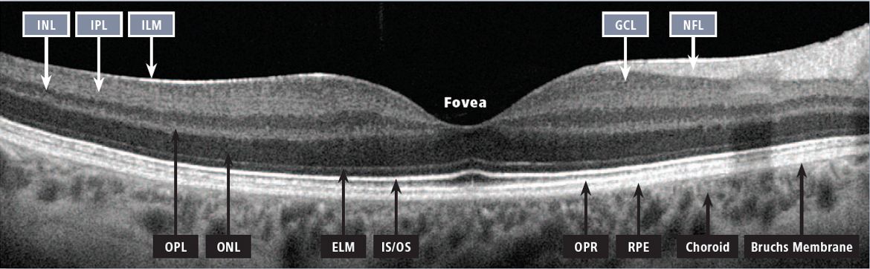
OCT B-Scan Layers

Slide 5
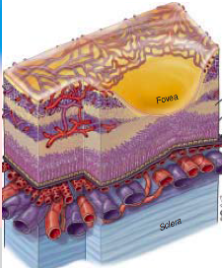
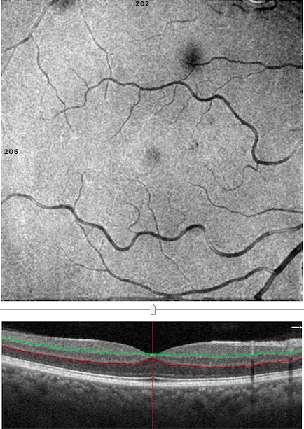
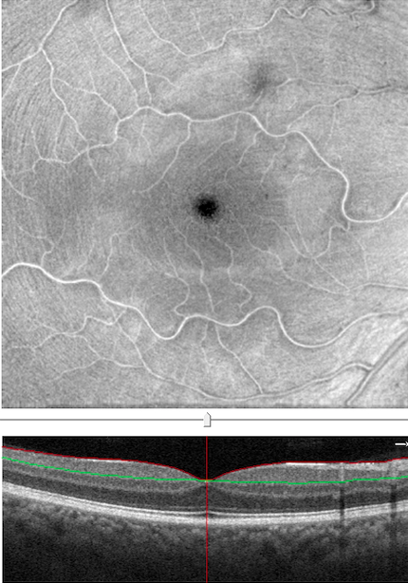
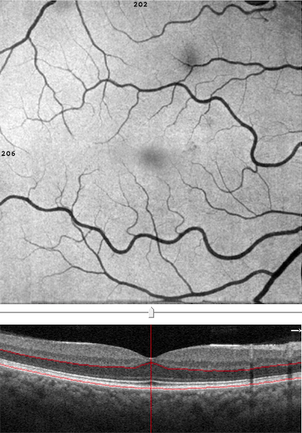
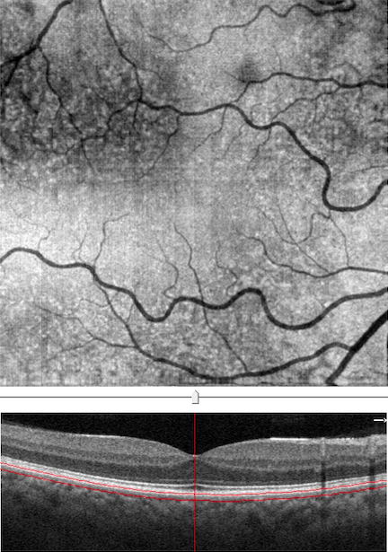
En Face Structural Visualization of Layers Based on Retinal Anatomy
https://www.optometrytimes.com/view/imaging-to-differentiate-disc-drusen-from-papilledema

Slide 6
Anomalies of the Vitreous

Slide 7
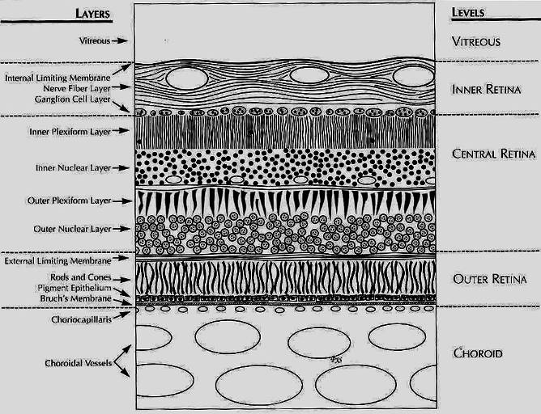
Pat Saine

Slide 8
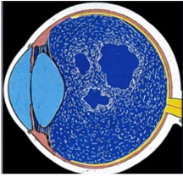
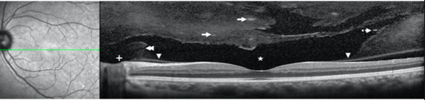
Aging of the Vitreous:
Two Processes
Synchysis (liquefaction of the vitreous gel)
https://ars.els-cdn.com/content/image/1-s2.0-S2211505615000800-gr2.jpg

Slide 9
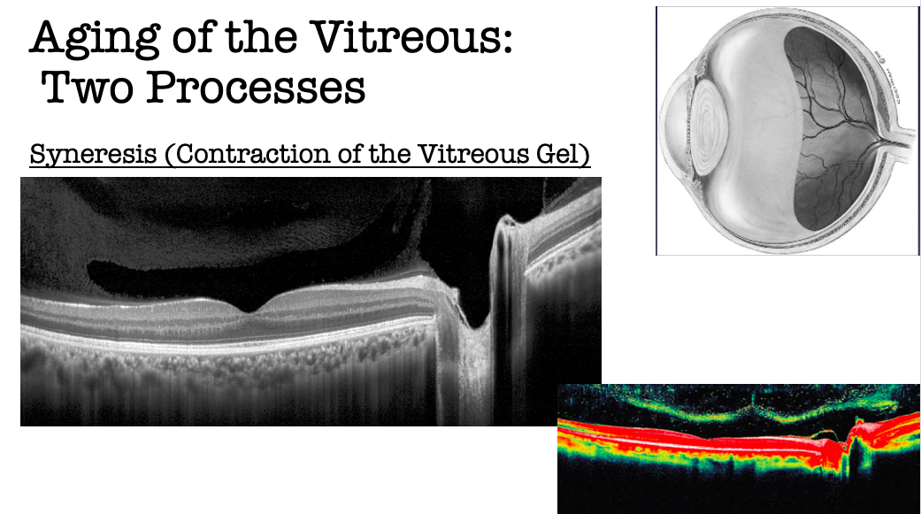
https://ars.els-cdn.com/content/image/1-s2.0-S2211505615000800-gr2.jpg

Slide 10
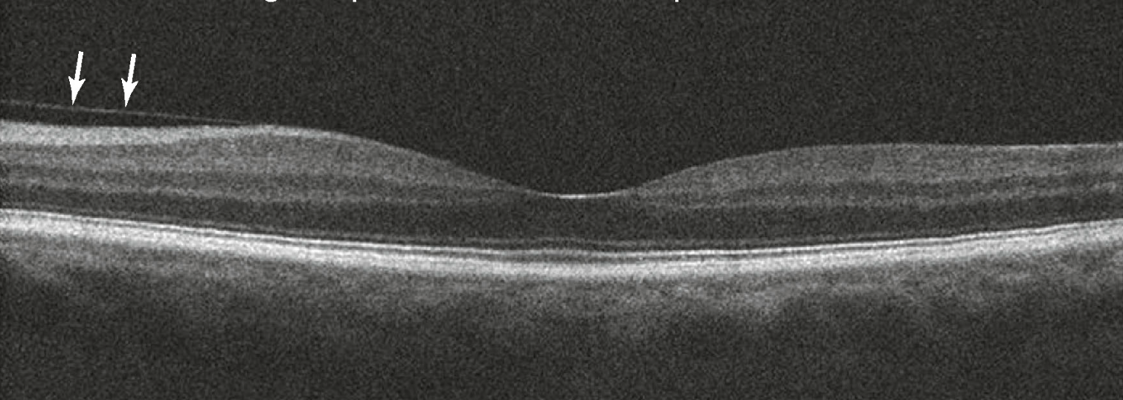
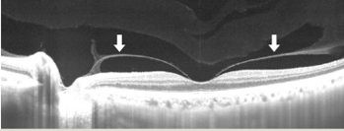
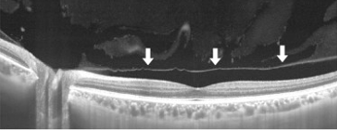
Stages of PVD
Stage 1:Single quadrant of perifoveal detachment
Stage 2: 360 degrees perifoveal detachment Stage 3: Vitreofoveal separation with adhesion at ONH
https://www.sciencedirect.com/science/article/pii/S2468653018304998
Notes:
Look at the behavior of the posterior vitreous cortex

Slide 11
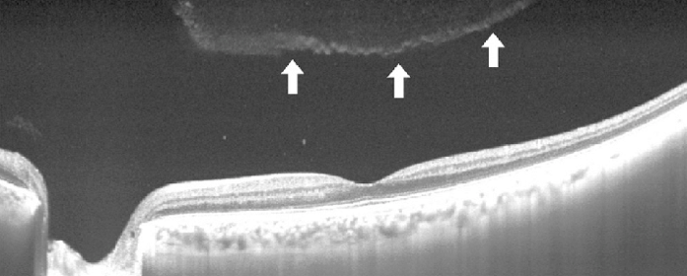
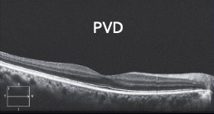
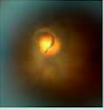
Complete Posterior Vitreous Detachment
https://www.researchgate.net/figure/Representative-OCT-images-of-the-stages-of-posterior-vitreous-detachment-PVD-classified_fig1_328832211

Slide 12
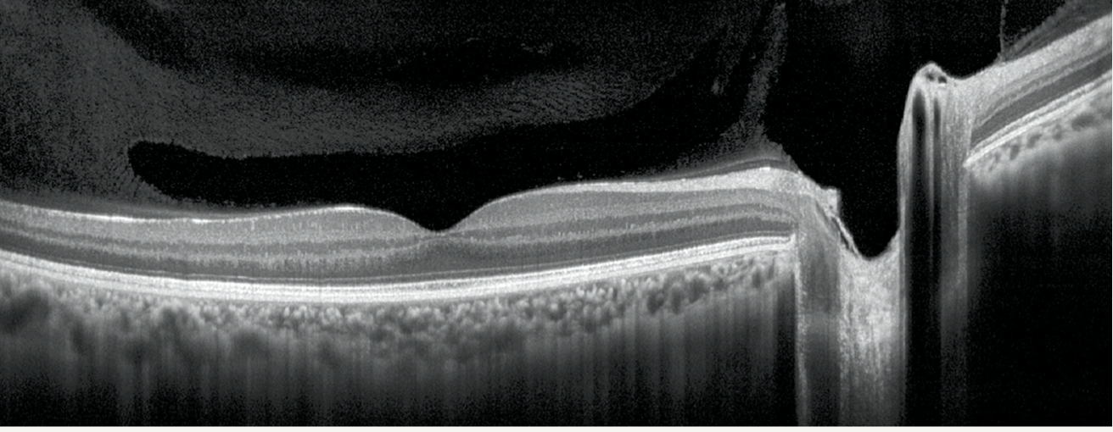
https://ars.els-cdn.com/content/image/1-s2.0-S2211505615000800-gr2.jpg

Slide 13
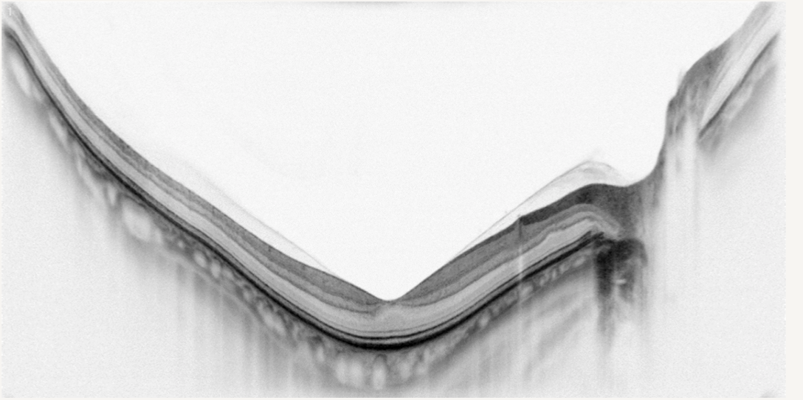
Vitreous behavior in a high myope
Adil Maftouhi
Notes:
Look at the behavior of the posterior vitreous cortex

Slide 14
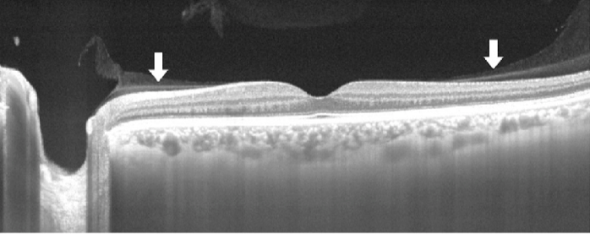
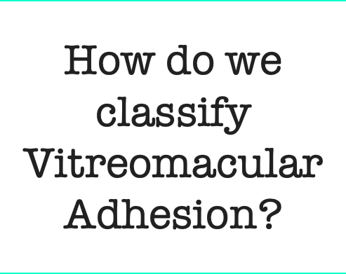
Vitreomacular Adhesion:
Paramacular PVD:

Slide 15
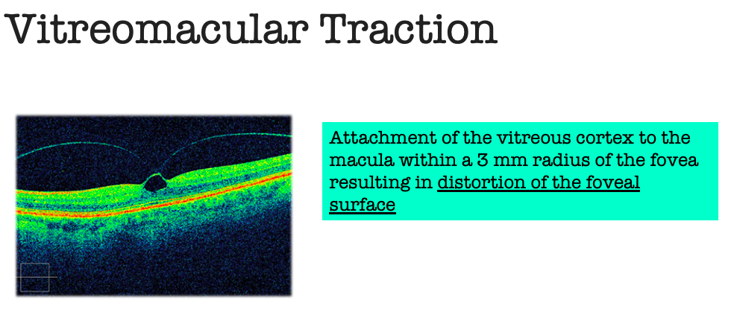

Slide 16
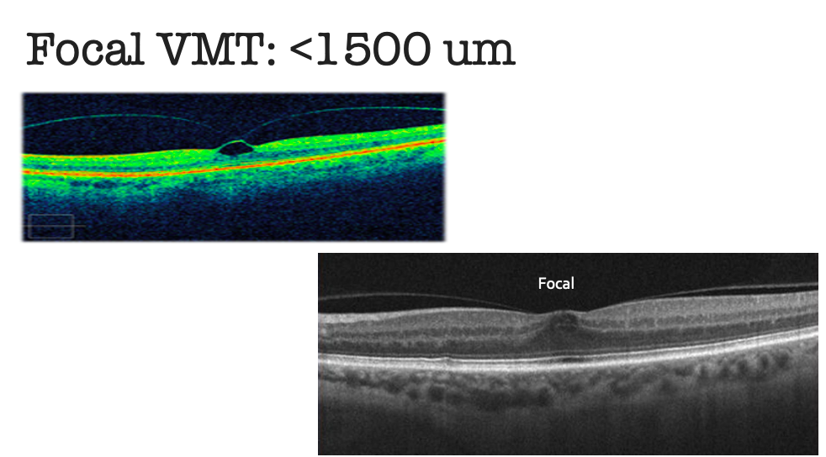

Slide 17
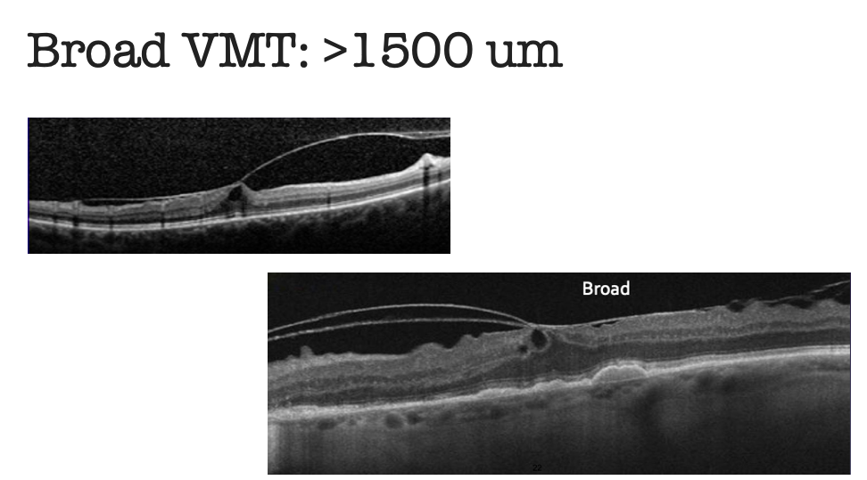

Slide 18
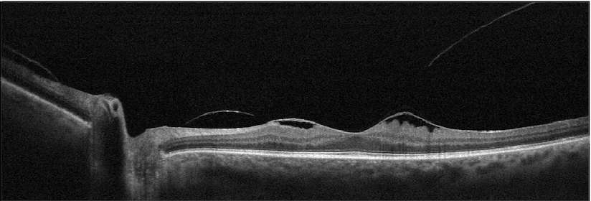
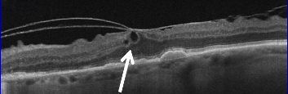
Isolated versus Concurrent
Isolated
Concurrent

Slide 19
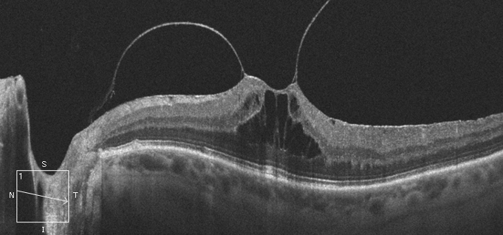
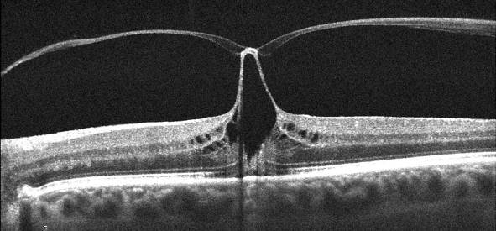
Which eye has the better visual prognosis?
Focal or Broad??
Isolated or Concurrent?
Integrity of PIL?
Notes:
19

Slide 20
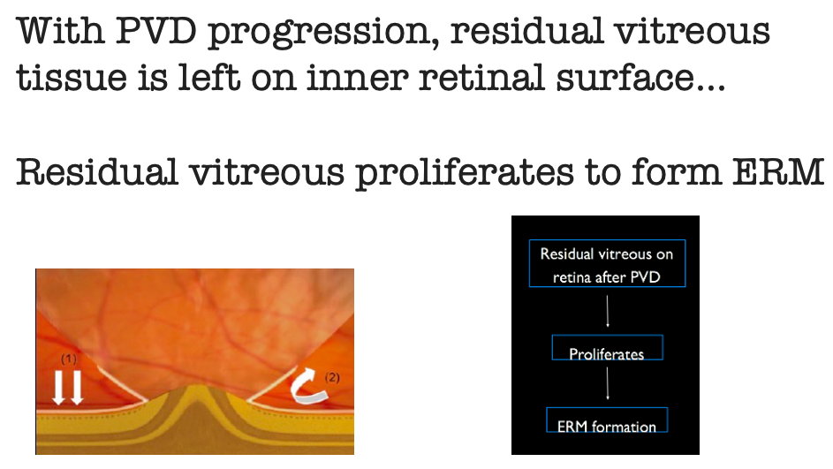
http://retinatoday.com/pdfs/0514RT_Global.pdf?__hstc=82057801.1bb630f9cde2cb5f07430159d50a3c91.1519171200063.1519171200064.1519171200065.1&__hssc=82057801.1.1519171200066&__hsfp=528229161

Slide 21
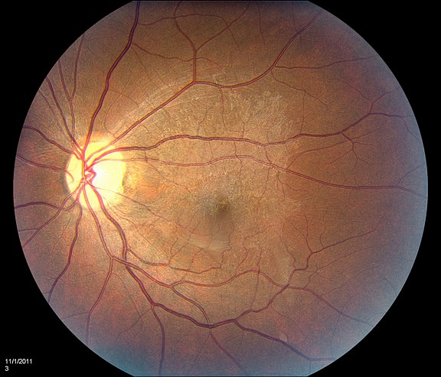
Epiretinal membrane: Grade 1
A cellophane-like sheen is observed over the macular area, causing very mild wrinkling of the inner retinal surface, with little or no modification of retinal vessel trajectory. These membranes are rarely symptomatic.
https://imagebank.asrs.org/discover-new/files/3/25?q=epiretinal%20membrane%20(ERM)

Slide 22
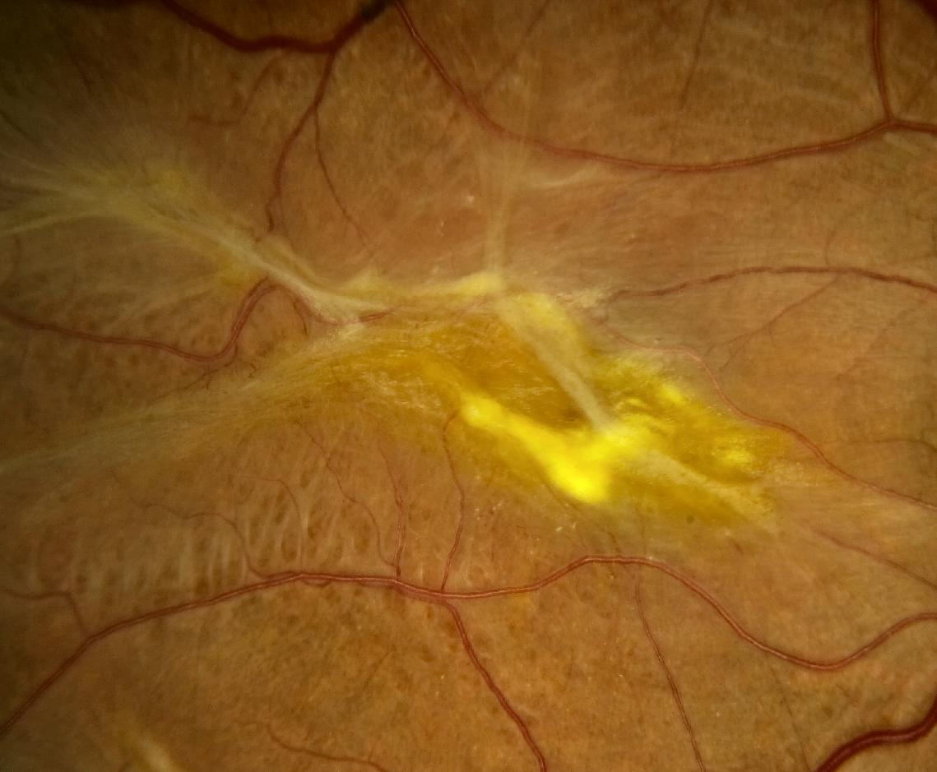
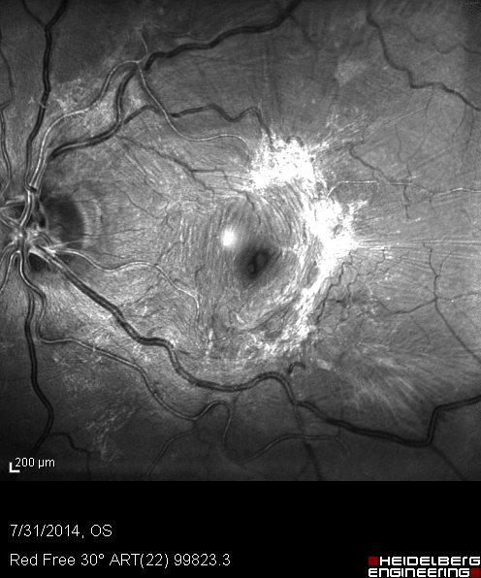
Epiretinal membrane: Grade 2
Fibrous tissue is observed over the macular area, causing significant wrinkling of the retinal surface and modification of the retinal vessel trajectory.

Slide 23
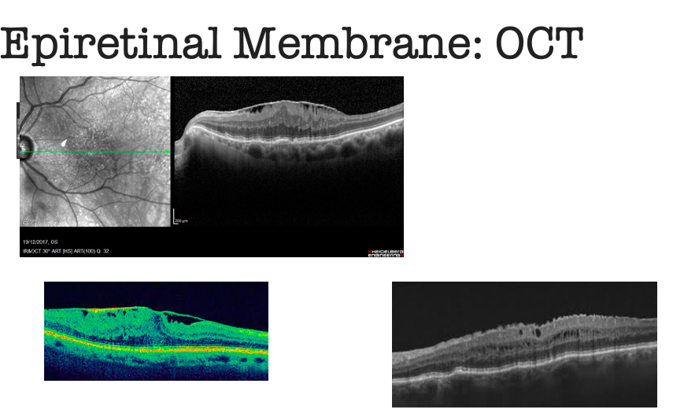
https://www.retinaky.com/macular-pucker-louisville/
https://bjo.bmj.com/content/98/Suppl_2/ii20

Slide 24
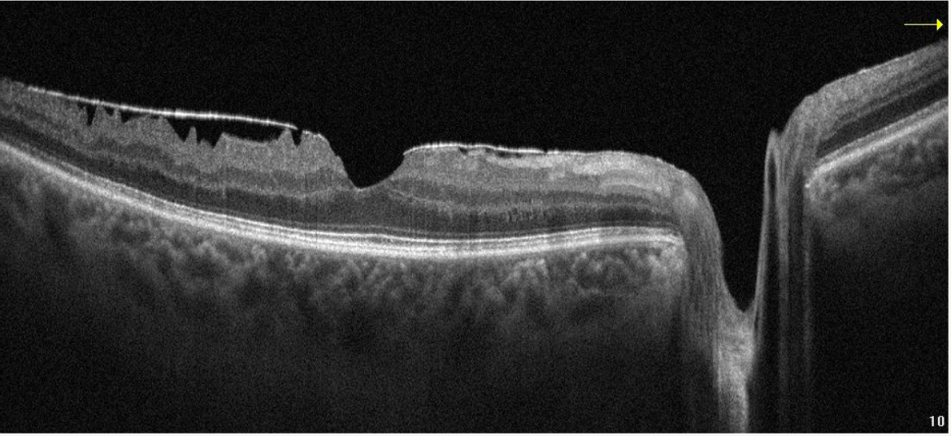
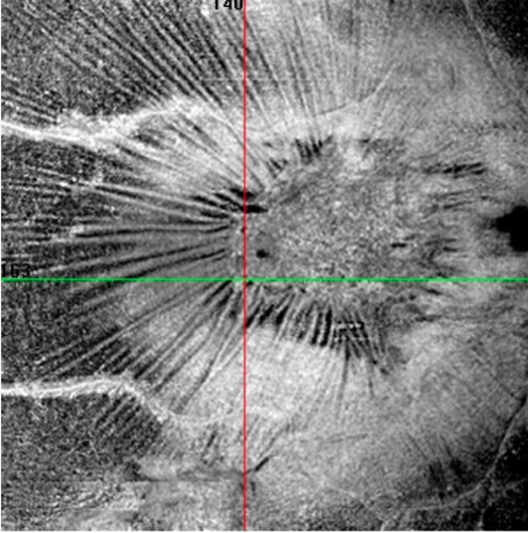
Adil Maftouhi

Slide 25
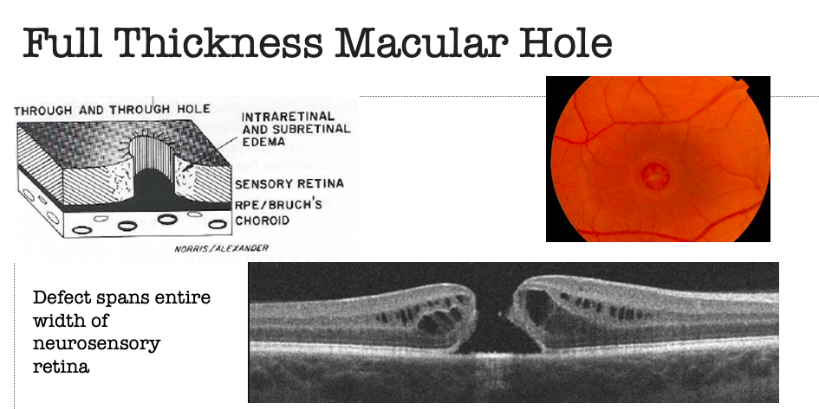
https://eyewiki.aao.org/Macular_Hole
https://journalretinavitreous.biomedcentral.com/articles/10.1186/s40942-018-0128-9

Slide 26

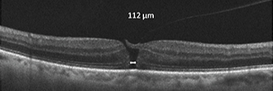
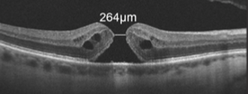
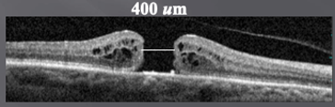
Small
Medium
Large
https://www.retinalphysician.com/issues/2014/april-2014/predictors-of-success-with-ocriplasmin-in-vmt-and

Slide 27
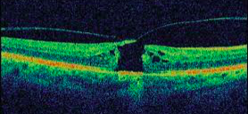

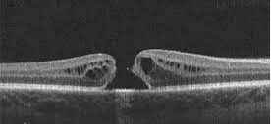

Is there VMT?? Primary versus Secondary
https://www.retinalphysician.com/issues/2014/april-2014/predictors-of-success-with-ocriplasmin-in-vmt-and
https://www.eyenews.uk.com/education/trainees/post/macular-holes-a-brief-review

Slide 28
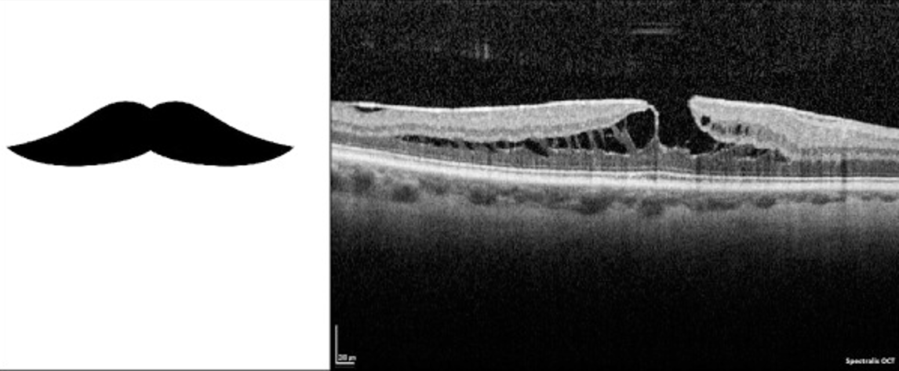
Partial Thickness Macular Hole: Lamellar
Tractional:
Epiretinal membrane
Foveal schisis
https://louisvillediabeticeyedoctor.com/wp-content/uploads/2016/04/Lamellar_Macular_Hole_Two_Distinct_Clinical_Entities_04-25-16.pdf

Slide 29
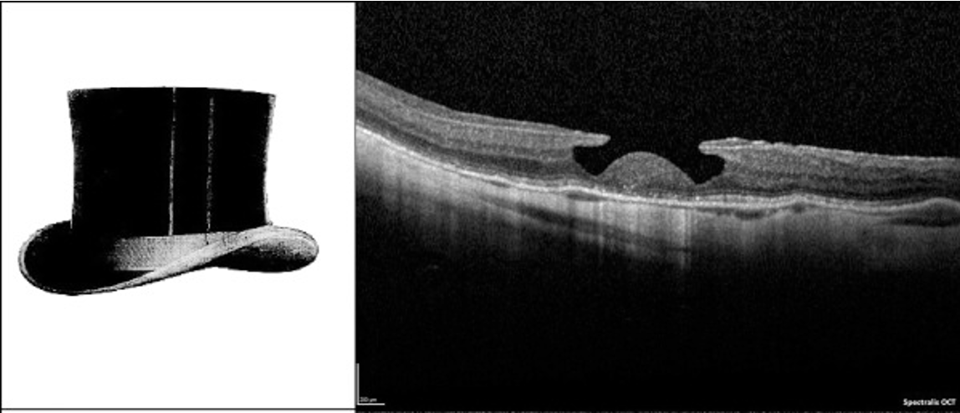
Partial Thickness Macular Hole: Lamellar
Degenerative:
Epiretinal proliferation
Round edges
Incomplete break
https://louisvillediabeticeyedoctor.com/wp-content/uploads/2016/04/Lamellar_Macular_Hole_Two_Distinct_Clinical_Entities_04-25-16.pdf

Slide 30
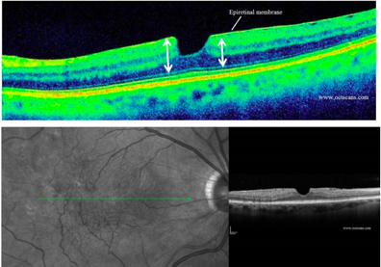
Partial Thickness Macular Hole: Pseudohole
https://www.octscans.com/vitreous-diseases.html

Slide 31
Inner Retinal Disease

Slide 32
Pat Saine

Slide 33
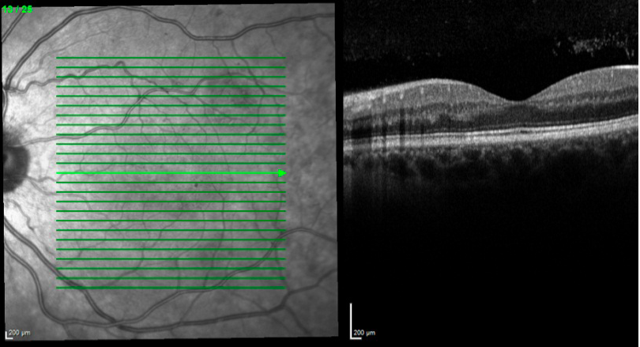
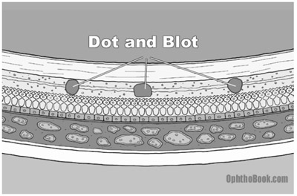
Diabetic Retinopathy: Non-Proliferative
Hemorrhage: HYPER-reflective
**Check the layer***
https://www.octscans.com/diabetic-retinopathy.html
Notes:
Hemorrhage: INL/OPL

Slide 34
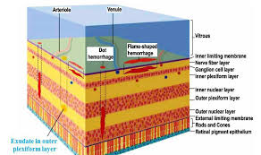
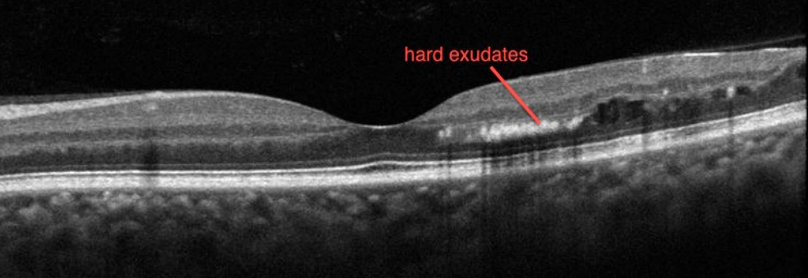
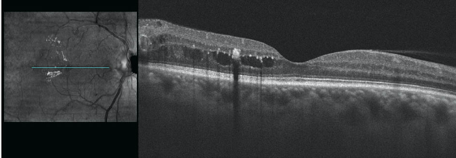
Diabetic Retinopathy: Non-Proliferative
Exudate: HYPER-reflective
**Check the layer***
https://www.octscans.com/diabetic-retinopathy.html
Notes:
Hemorrhage: INL/OPL

Slide 35
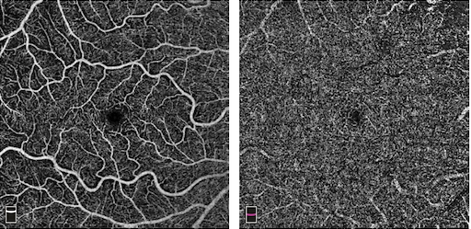
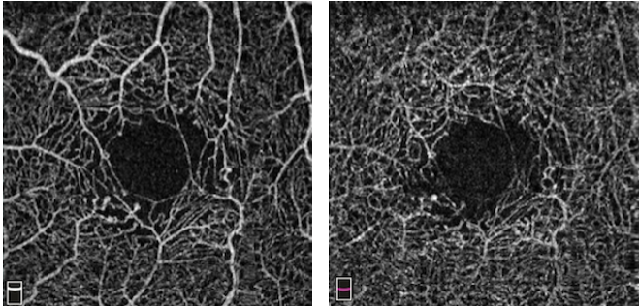
Normal: SCP/DCP
What about OCTA in NPDR?

Slide 36

Diabetic Retinopathy: Macular Edema
AAO>org

Slide 37


Diabetic Retinopathy: Macular Edema
HYPO-Reflective: Serous Fluid
https://www.google.com/url?sa=i&url=https%3A%2F%2Fwww.octscans.com%2Fdiabetic-retinopathy.html&psig=AOvVaw1nuIyk_0G1TGPdzvGdc7MX&ust=1616789859237000&source=images&cd=vfe&ved=2ahUKEwi2vZTboczvAhVT2VkKHbldB1gQr4kDegUIARDEAQ
https://www.aao.org/eyenet/article/diabetic-macular-edema-personalizing-treatment

Slide 38




Macular Edema: CI versus NCI
https://www.mieducation.com/pages/diabetic-macular-oedema-detection-and-treatment-to-laser-or-inject
https://www.aao.org/eyenet/article/diabetic-macular-edema-personalizing-treatment

Slide 39


Ancillary Testing: OCTA
Macular Ischemia!!
https://www.sciencedirect.com/science/article/pii/S0042698917300950#f0045

Slide 40


Diabetic Retinopathy: Proliferative
https://www.octscans.com/diabetic-retinopathy.html
https://openi.nlm.nih.gov/detailedresult?img=PMC4220398_OJO-7-126-g006&query=bursitis&it=xg&req=4&simCollection=PMC4603217_JoU-2013-0033-g003
https://www.topcon-medical.it/files/Local_TIT/OCT_Triton/Triton_brochure_Topcon_it.pdf
Notes:
NVD fibrovascular membrane

Slide 41


Diabetic Retinopathy: Proliferative
https://www.ncbi.nlm.nih.gov/books/NBK558952/figure/article-35593.image.f3/
https://openi.nlm.nih.gov/detailedresult?img=PMC4220398_OJO-7-126-g006&query=bursitis&it=xg&req=4&simCollection=PMC4603217_JoU-2013-0033-g003
https://www.topcon-medical.it/files/Local_TIT/OCT_Triton/Triton_brochure_Topcon_it.pdf
Notes:
NVD fibrovascular membrane

Slide 42



Vein Occlusion

Slide 43

Artery Occlusion: Acute

Slide 44

Artery Occlusion:
Chronic
http://www.retinareference.com/diseases/7f5ad78f2b76973f/images/890d99a95b/

Slide 45
Macular Telangiectasia

Slide 46



What is Macular Telangiectasia 2?
Proposed hypothesis: Neuro-degenerative disorder
Originates from abnormality in the Muller Cells
Integrity of retinal vasculature affected
The major role of the Müller cells is to maintain the structural and functional stability of retinal cells
https://www.aao.org/bcscsnippetdetail.aspx?id=c26176c2-66e2-4a25-96d1-b715d1661cfb
Notes:
Our knowledge about the pathophysiology of the disease has changed over the last few years. Gass et al. first assumed that the disease was caused by vascular dysfunction and subsequent hypoperfusion, and the disease actually had a vascular base. But our understanding of the disease has since changed. Our current understanding is that the disease is neurodegenerative in nature, originating from an abnormality in the Muller cells. The major role of the Müller cells is to maintain the structural and functional stability of retinal cells. The clinical findings that occur with mactel result as a sequelae from this muller cell dysfunction and resultant retinal instability.

Slide 47




What is Macular Telangiectasia 2?
Proposed hypothesis: Neurodegenerative disorder
Muller cell depletion: telangiectasia and vessel dilation
Photoreceptor death
Weakening of blood retinal barrier
https://www.semanticscholar.org/paper/POSSIBLE-CHOROIDAL-NEOVASCULARIZATION-IN-MACULAR-2.-Balaratnasingam-Yannuzzi/2629da69ddcf0d9aaf02d84cf8533b0ef2315957/figure/4
Notes:
Muller cell depletion and abnormality result in dilation and weakening and telangiectasia of retinal vessels. Loss of functionality within the neurosensory retina will result in eventual death of the photoreceptors. Loss of photoreceptors weakens the inner retinal/outer retinal barrier which allows for abnormal vessels to invade into the subretinal and subrpe space.

Slide 48



Slide 49




Slide 50



OCT: Normal
Muller Cells
https://www-ncbi-nlm-nih-gov.ezproxylocal.library.nova.edu/pmc/articles/PMC5518977/pdf/i1552-5783-58-9-3683.pdf

Slide 51


“ILM DRAPE”
Hypo-reflective cavities in inner retina
https://www.nature.com/articles/s41598-020-73803-9

Slide 52


ENLARGEMENT OF ILM DRAPE
INVOLVEMENT OF OUTER RETINA; IS/OS

Slide 53




CAVITY SPANS TO OUTER RETINA
MACULAR HOLE FORMATION
SUBRETINAL NEOVASCULARIZATION
https://www.nature.com/articles/s41598-020-73803-9

Slide 54
Outer Retinal Disease

Slide 55
Pat Saine

Slide 56


Drusen
https://benthamopen.com/FULLTEXT/TOOPHTJ-13-90/FIGURE/F3/

Slide 57


https://www-clinicalkey-com.ezproxylocal.library.nova.edu/#!/content/book/3-s2.0-B9780323461214000091

Slide 58




Reticular Pseudodrusen
https://www.aaojournal.org/article/S0161-6420(09)00756-8/pdf

Slide 59

Pigment Epithelial Detachments
Serous
Drusenoid
Hemorrhagic

Slide 60

Pigment Epithelial Detachments: What Kind?

Slide 61

Central Serous Chorioretinopathy
https://www.ceenta.com/patient-resources/central-serous-retinopathy

Slide 62

Central Serous Chorioretinopathy: Chronic

Slide 63


Central Serous Chorioretinopathy and PED
https://webeye.ophth.uiowa.edu/eyeforum/cases/291-central-serous-chorioretinopathy.htm

Slide 64

Age Related Macular Degeneration

Slide 65

Adil Maftouhi

Slide 66

Occult:
Under the RPE

Slide 67

Age Related Macular Degeneration

Slide 68

Age Related Macular Degeneration

Slide 69

Age Related Macular Degeneration

Slide 70

Classic:
Above the RPE

Slide 71


Geographic Atrophy
https://www-clinicalkey-com.ezproxylocal.library.nova.edu/#!/content/book/3-s2.0-B9780323461214000108

Slide 72



https://www-clinicalkey-com.ezproxylocal.library.nova.edu/#!/content/book/3-s2.0-B9780323461214000108

Slide 73


Vitelliform Dystrophy
https://www.researchgate.net/figure/Natural-course-of-vitelliform-stage-in-BVMD-over-5years-of-follow-up-The-typical_fig1_337990690

Slide 74

Solar/Laser Maculopathy
Accidental or purposeful prolonged exposure to intense light sources such as the sun (as may happen in psychiatric disease or during a solar eclipse), a welding arc, or an operating microscope can result in photochemical injury to the macula
• The inner retina is normal.
• Focal disruption or loss of the retinal pigment epithelial (RPE) and inner segment/outer segment/ellipsoid zone (IS/IO/EZ), with sharply demarcated borders of normal retina on the edge
https://www-clinicalkey-com.ezproxylocal.library.nova.edu/#!/browse/book/3-s2.0-C20210017594

Slide 75

Solar/Laser Maculopathy
https://www-clinicalkey-com.ezproxylocal.library.nova.edu/#!/browse/book/3-s2.0-C20210017594

Slide 76
Outer Retinal Disease
Pachychoroid Clinical Spectrum
Pachychoroid Spectrum refers to a group of clinical entities that have a common characteristic: a pachychoroid (thick choroid)

Slide 77


https://www.researchgate.net/publication/323620626_Automated_quantification_of_Haller's_layer_in_choroid_using_swept-source_optical_coherence_tomography

Slide 78
Features of the Choroid
Choroidal thickness varies with age, ethnicity and axial length
Normal subfoveal choroidal thickness 250-350 um
Pachychoroid: Choroidal thickness >390 um;
  Extrafoveal thickness exceeding subfoveal by 50 um
https://link.springer.com/article/10.1007/s10384-020-00740-5/figures/1

Slide 79
Chorioretinal Disease affects choroidal thickness!
Thicker
Central Serous Chorioretinopathy
Polypoidal Choroidal Vasculopathy
Thinner
Age Related Macular Degeneration
Proliferative DR/ DME
Retinitis Pigmentosa
Glaucoma
https://link.springer.com/article/10.1007/s10384-020-00740-5/figures/1

Slide 80

Choroid: In Detail

Slide 81

Choroid: In Detail (Pachychoroid)

Slide 82


Enhanced Depth Imaging
Place OCT closer to patient’s eye; improves image resolution
Inverting the image provides enhanced visualization of the RPE, Bruch’s membrane, choroid and sclera (extra 500-800 um penetration)
https://www.bioz.com/result/spectralis/product/heidelberg%20engineering

Slide 83


CSR: Thick
AMD: Thin
https://www.researchgate.net/figure/Optical-coherence-tomography-in-dry-AMD-The-choroid-is-thin-the-choroidal-vessels_fig3_258955680

Slide 84


CSR vs AMD
65 yo
Active CSR
66 yo
Exudative AMD

Slide 85
Pachychoroid Clinical Spectrum
Uncomplicated Pachychoroid
Central serous chorioretinopathy (CSC)
Pachychoroid neovasculopathy
Polypoidal choroidal vasculopathy
Focal Choroidal Excavation

Slide 86

Pachychoroid Clinical Spectrum
Uncomplicated Pachychoroid
No RPE alterations
No subretinal fluid
Thick choroid, dilated Haller’s layer vessels
Retina Imaging Channel
Notes:
IR clean: no hyper or hypo because no RPE alterations

Slide 87


Pachychoroid Clinical Spectrum
Central Serous Chorioretinopathy
https://en.wikipedia.org/wiki/Pachychoroid_disorders_of_the_macula
https://entokey.com/central-serous-chorioretinopathy-and-pachychoroid-disease/

Slide 88

Pachychoroid Clinical Spectrum
Pachychoroid Neovasculopathy
Type 1 CNV with thick choroid!
https://entokey.com/central-serous-chorioretinopathy-and-pachychoroid-disease/

Slide 89

Pachychoroid Clinical Spectrum
Polypoidal Choroidal Vasculopathy

Slide 90

Serosanguinous RPE detachments
Serous Fluid
Blood
Double layer sign: Suggestive of CNVM
http://www.ijo.in/viewimage.asp?img=IndianJOphthalmol_2018_66_7_896_234954_f2.jpg

Slide 91



Pachychoroid Clinical Spectrum
Focal Choroidal Excavation
  Conforming (photoreceptor tips are in direct contact with RPE)
  Non-conforming (photoreceptor tips are detached from RPE)
https://www.dovepress.com/choroidal-cavitary-disorders-peer-reviewed-fulltext-article-OPTH

Slide 92
Melanocytic Lesions

Slide 93


Choroidal Nevus
Flat to minimal thickening is seen.
• Well-defined blocking of signal occurs in the outer choroid.
• Overlying choriocapillaris is compressed
Overlying retina may have cystic changes or localized subretinal fluid.
https://www-clinicalkey-com.ezproxylocal.library.nova.edu/#!/browse/book/3-s2.0-C20210017594

Slide 94


Choroidal Melanoma
Elevated choroidal mass with extensive blocking of signal
Obscuration of the normal choroidal vascular pattern in the area of the tumor
Overlying subretinal fluid is present with shaggy photoreceptor
https://www-clinicalkey-com.ezproxylocal.library.nova.edu/#!/browse/book/3-s2.0-C20210017594

Slide 95

Multimodal imaging of choroidal melanoma
https://retinatoday.com/articles/2016-july-aug/which-tumor-what-imaging-modality

Slide 96

Simple Hamartoma of the RPE
Congenital simple hamartoma of the retinal pigment epithelium (RPE) is an uncommon, benign tumor of the RPE that appears as a jet-black, well-demarcated, round lesion on the foveal surface
https://www-clinicalkey-com.ezproxylocal.library.nova.edu/#!/browse/book/3-s2.0-C20210017594

Slide 97

Simple Hamartoma of the RPE
Congenital simple hamartoma of the retinal pigment epithelium (RPE) is an uncommon, benign tumor of the RPE that appears as a jet-black, well-demarcated, round lesion on the foveal surface
https://www-clinicalkey-com.ezproxylocal.library.nova.edu/#!/browse/book/3-s2.0-C20210017594

Slide 98


Combined Hamartoma of the Retina and RPE
Combined hamartoma of the retina and retinal pigment epithelium (RPE) is a rare, benign hamartomatous growth.
The usual clinical appearance is a peripapillary, pigmented, focal disorganization of the retina, with overlying fibrosis.
https://www-clinicalkey-com.ezproxylocal.library.nova.edu/#!/browse/book/3-s2.0-C20210017594

Slide 99
Plaquenil Toxicity

Slide 100


What is Hydroxychloroquine (Plaquenil)?
Disease-modifying anti-rheumatic drug (DMARD)
Originally anti-malarial
Used to treat rheumatoid arthritis, lupus, and other inflammatory and dermatologic conditions

Slide 101

What is Hydroxychloroquine (Plaquenil)?
Metabolite of chloroquine
Longer half life
  Less drug needed for efficacy
Binds to melanin in RPE
  Results in Bulls-Eye Maculopathy

Slide 102


Dose:
  Maximum daily HCQ use of < 5.0 mg/kg real weight
Duration:
  At recommended dosage, risk of toxicity up to 5 years is under 1% and up to 10 years is under 2%... BUT 20% AFTER 20 YEARS!!!
High dose and long duration of use are most significant risk factors

Slide 103

JAMA Ophthalmol 2014;132:1453e60
Notes:
KaplaneMeier curves showing the cumulative risk of retinopathy over time, with different levels of hydroxychloroquine (HCQ) use. When use is between 4.0 and 5.0 mg/kg, the risk is very low within the first 5 to 10 years, but it increases markedly thereafter.

Slide 104
Major Risk Factors:
  Concomitant renal disease
    Subnormal glomerular filtration rate
  Concomitant Drugs
    Tamoxifen Use
Retinopathy is not reversible!!
Notes:
concomitant tamoxifen (a drug used for long-term treatment of breast cancer) increased the risk of toxicity approximately 5 fold

Slide 105

Screening Schedule
Baseline Screening
  Fundus examination within first year of use
  Add VFs and OCT if maculopathy is present
Annual Screening
  Begin after 5 years of use
  Sooner in the presence of major risk factors
JAMA Ophthalmol 2014;132:1453e60
Notes:
Baseline sceening- assess the presence of preexisting maculopathies

Slide 106
65-year-old Caucasian Female
Complaints of “central darkening” OU
  Progressive worsening
History of rheumatoid arthritis (20+ years)
BCVA:
  OD 20/40; OS 20/40-
Medications:
Methotrexate
Plaquenil: 400 mg x 20 years

Slide 107

Risk of Plaquenil Maculopathy
Step 1: Evaluate the dosage:
150 lb. converts to 68 kg
400mg/68 kg = 5.88 mg/kg

Slide 108

Risk of Plaquenil Maculopathy
Step 2: Evaluate the duration:
20 years of use and dosage higher than recommended

Slide 109
JAMA Ophthalmol 2014;132:1453e60
Notes:
KaplaneMeier curves showing the cumulative risk of retinopathy over time, with different levels of hydroxychloroquine (HCQ) use. When use is between 4.0 and 5.0 mg/kg, the risk is very low within the first 5 to 10 years, but it increases markedly thereafter.

Slide 110

Risk of Plaquenil Maculopathy
Step 3: Assess other major risk factors:
This patient does not have any other major risk factors

Slide 111


Dilated Fundus Examination
Ring of parafoveal RPE depigmentation sparing fovea
“Bull’s Eye Maculopathy”

Slide 112

Ancillary Testing
10-2 Humphrey Visual Field
Dense ring scotoma bilaterally
Notes:
Asians: partial ring scotoma outside the parafoveal region – use 24 or 30

Slide 113

Ancillary Testing:
Optical Coherence Tomography
https://www.researchgate.net/figure/Top-Normal-Spectralis-spectral-domain-optical-coherence-tomography-SD-OCT-image-with_fig3_49602243
Recommendations on Screening for Chloroquine and Hydroxychloroquine Retinopathy (2016 Revision)
Notes:
Normal Spectralis spectral domain optical coherence tomography (SD OCT) image with intact photoreceptor inner segment/outer segment junction (IS/ OS). Bottom: SD OCT showing the "flying saucer" sign of hydroxychloroquine retinopathy, an ovoid appearance of the central fovea created by preservation of central foveal outer retinal structures (seen between the black arrows) surrounded by perifoveal loss of the photoreceptor IS/OS junction, and perifoveal outer retinal thinning.

Slide 114


Slide 115


Ancillary Testing:
This patient
Notes:
severe retinopathy with a prominent bull’s-eye macular lesion, RPE damage on SD OCT
Parafoveal and now foveal thinning with loss of outer segment structural lines (including IS/OS junction)

Slide 116


Toxicity Variation: Asians
Classic ”bulls-eye” pattern of toxicity is infrequent in Asian patients; initial damage is seen in a more peripheral extramacular distribution near the arcades.
Recommendations on Screening for Chloroquine and Hydroxychloroquine Retinopathy (2016 Revision)
Notes:
VF: showing partial ring scotoma outside the parafoveal region; (SD OCT) cross-section showing marked loss of outer nuclear
layer and ellipsoid zone and beginning retinal pigment epithelium (RPE) disruption at the outer
edge of the scan (right arrow)

Slide 117
Clinical Pearl
Maculopathy is NOT reversible and damage may progress even after drug cessation. Once ”bull’s eye” is seen… we are too late!!!
However, when retinopathy is identified early, there is only mild and limited progression after discontinuing the medication.
SCREENING ENABLES EARLY DETECTION!!
Recommendations on Screening for Chloroquine and Hydroxychloroquine Retinopathy (2016 Revision)

Slide 118
Optic Nerve OCT

Slide 119


https://www.opticianonline.net/cet-archive/52

Slide 120



Papilledema
Important features of disc edema on OCT:
Smooth contour of elevation
Nasal RNFL >86 um
Thick hypo-reflective space adjacent to disc “lazy V” (Especially nasal)
https://www.ophthalmologymanagement.com/issues/2015/december-2015/the-papilledema-dilemma
https://www.restorevisionclinic.com/blog/idiopathic-intracranial-hypertension-vision-at-risk
Notes:
The “V” contour is presumed to be due to hydrostatic pressure from the ONH leaking into the subretinal space, resulting in an enlarged separation between the neurosensory retina and retinal pigmented epithelium (RPE).

Slide 121


Papilledema
Increased ICP will push the globe anteriorly
With EDI, can see an anteriorly displaced Bruch’s membrane

Slide 122

ONH Drusen
A: Signal Poor Core
B. Hyperreflective Cap
C. Multiple small hyperreflective aggregates within a signal poor core
D. PHOMS (peripapillary hyperreflective ovoid mass: NOT drusen

Slide 123


ONH Drusen
Irregular, bumpy contour
Hypo-reflective centers
Hyper-reflective margins
https://www.optometrytimes.com/view/imaging-to-differentiate-disc-drusen-from-papilledema

Slide 124


ONH Drusen
Reflectance of Hyaline and Shadowing beneath:
Not seen in cases of papilledema
https://www.ophthalmologymanagement.com/issues/2015/december-2015/the-papilledema-dilemma

Slide 125



Yellow arrows: Drusen with a hyporeflective core and hyperreflective margin
White arrows: Conglomerates of hyperreflective thin lines may represent early drusen
Yellow circles: PHOMS

Slide 126


Slide 127
Anatomy of a Corneal OCT Scan
Normal Scan

Slide 128

Normal Cornea

Slide 129




Epithelial/Sub-Epithelial Dystrophies
Map Dot Fingerprint

Slide 130



Epithelial/Sub-Epithelial Dystrophies
Reis Buckler

Slide 131



Stromal Dystrophies
Granular

Slide 132




Stromal Dystrophies
Lattice

Slide 133



Stromal Dystrophies
Macular

Slide 134



Stromal Dystrophies
Schnyder Crystalline

Slide 135


Endothelial Dystrophies
Fuch’s Endothelial

Slide 136

Endothelial Dystrophies
Posterior Polymorphous

Slide 137



Keratic Precipitates

Slide 138

Angle
Measurement
cornea

Slide 139


Angle Measurement
Normal
Narrow
Notes:
EXAMPLES OF THE NEW HIGH DEF IMAGES AVAILABLE WITH SOME OF THE NEW IMAGING TECHNOLOGY.

Slide 140
How narrow is the angle???
Light
Dark

Slide 141
Thank you!!!
rjulie@nova.edu

