Slide 1
Advances in Retinal Disease Therapy
Where we are at, what’s new and what’s coming
By Luis G. León-Alvarado, MD

Slide 2
About #FRI
Florida Retina Institute, a beacon of trust and innovation in vitreous and retinal ophthalmology for over 45 years, stands as the premier provider known for its compassionate care and cutting-edge expertise.
With a distinguished team of 15 board-certified doctors and surgeons, state-of-the-art technology,
and a commitment to clinical trials and research, patients trust Florida Retina Institute to continuously
deliver the highest standard of treatment and preserve their vision.

Slide 3

Positively Vision Focused®
20 Locations
throughout
Central Florida,
North Florida and
South Georgia

Slide 4
The most likely cause of visual loss in the aging population is cataract development.

Slide 5
Learning Objectives
Understand Current Treatment Modalities
  Identify key therapies available for retinal diseases.
  Discuss mechanisms of action and clinical outcomes.
Anti-VEGF Therapies
  Explain the role of VEGF in retinal diseases.
  Review the function and differences among anti-VEGF agents, including Avastin(Bevacizumab), Lucentis(Ranibizumab, Eylea(Aflibercept 2mg), Beovu(Brolucizumab), Vabysmo(Faricimab), and Eylea HD(Aflibercept 8mg).

Slide 6
Learning Objectives
Dual-Targeting Therapies
  Evaluate therapies that target multiple pathways, such as VEGF-A and Ang2, for enhanced efficacy.
Emerging Drug Delivery Systems
  Discuss advances in sustained drug delivery systems like PDS-Susvimo, Iluvien, and Ozurdex implants.
  Highlight their impact on reducing treatment frequency and improving patient adherence.

Slide 7
Learning Objectives
Corticosteroid Therapies
  Describe corticosteroid treatments and their role in reducing inflammation and edema.
  Evaluate different corticosteroid implants such as Ozurdex(Dexamethasone), Iluvien (Fluocinolone Acetonide), and Yutiq(Fluocinolone Acetonide).
Complement Inhibitors for Geographic Atrophy (GA)
  Define complement activation and its impact on GA.
  Assess treatments like Syfovre (Pegcetacoplan) and Izervay (Avancipated Pegol) for slowing disease progression.

Slide 8
Learning Objectives
Gene Therapy Approaches
  Understand gene therapy applications for inherited and chronic retinal diseases.
  Explore treatments like Luxturna, ABBV-RGX-314, and Ixo-Vec for addressing genetic mutations and VEGF suppression.
Stem Cell Therapies
  Examine the potential of stem cell therapy for retinal cell replacement and function restoration.
  Conditions like GA and Stargardt Disease.

Slide 9
Learning Objectives
Future Directions and Innovations
  Recognize ongoing research trends and potential breakthroughs in retinal disease therapy.
  Identify the challenges and opportunities in personalized treatment approaches.

Slide 10
Introduction
Targeted Conditions (overview)
- Wet AMD
- Diabetic Macular Edema (DME)
Retinal Vein Occlusion (RVO)
Geographic Atrophy (GA)
Inherited Retinal Disease (IRD)
Therapeutic Approaches
- Anti-VEGF Treatments
- Corticosteroid Therapies
Gene and Stem Cell Therapies
Eyedrops
- Emerging Drug Delivery Systems

Slide 11
Wet AMD (Exudative Age Related Macular Degeneration)
Chronic eye disorder characterized by the growth of abnormal blood vessels (choroidal neovascularization) beneath the macula
These fragile vessels leak blood and fluid, leading to retinal damage, scarring, and rapid central vision loss if left untreated.
Wet AMD represents approximately 10–15% of AMD cases
Responsible for most of the severe vision loss associated with the disease.

Slide 12
Wet AMD
Pathophysiology
The hallmark of wet AMD is the overexpression of vascular endothelial growth factor (VEGF)
Promotes angiogenesis and increased vascular permeability.
Disrupt the normal retinal architecture, resulting in visual distortion (metamorphopsia), blurring, and central scotomas.

Slide 13
Wet AMD
Epidemiology and Demographics
AMD is the leading cause of vision loss in individuals over the age of 50 in developed countries.
      Approximately 196 million people worldwide were affected by AMD in 2020, a number expected to rise to 288 million by 2040 due to population aging.
10–15% progress to the neovascular (wet) form, but this subgroup accounts for 90% of cases of severe vision loss caused by AMD.
    Risk increases significantly with age. Wet AMD is most common in individuals over 60 years old, with a prevalence of up to 12% in those over 80.
Some Studies indicate a slightly higher prevalence in women than men.
Caucasians are at higher risk compared to African Americans or Asians.

Slide 14
Wet AMD
Risk Factors
Genetics: Family history of AMD significantly raises susceptibility.
Smoking: Smokers have a 2-3 times higher risk compared to non-smokers.
Hypertension and Cardiovascular Disease: Associated with higher rates of progression to wet AMD.
Obesity and Diet: Poor dietary intake of antioxidants and omega-3 fatty acids increases risk.
Environmental Factors: UV exposure and oxidative stress contribute to retinal damage.

Slide 15
Wet AMD
Current Treatment Approaches
Anti-VEGF Therapy: Intravitreal injections of VEGF inhibitors Anti-VEGF agents, including Avastin(Bevacizumab), Lucentis(Ranibizumab, Eylea(Aflibercept 2mg), Beovu(Brolucizumab), Vabysmo(Faricimab), Eylea HD(Aflibercept 8mg).
First-line treatment, effectively stabilizing or improving vision in 90% of patients.
Photodynamic Therapy (PDT): Less commonly used but still applicable in select cases
Laser Photocoagulation: Used for extrafoveal lesions but largely replaced by anti-VEGF
treatments.
Implantable drug delivery systems
Gene Therapy

Slide 16
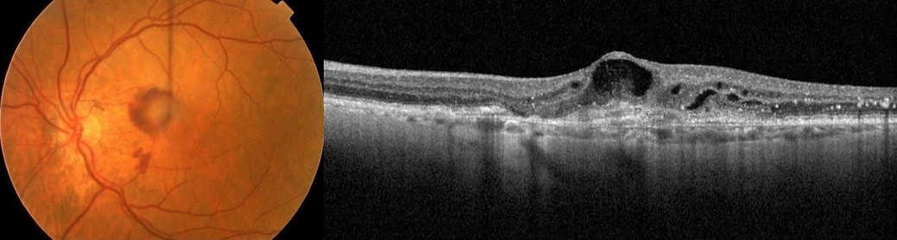
Wet AMD

Slide 17
Intravitreal injections
Intravitreal injection is the most common route of medication administration for retinal therapies.
Usual volume administered 0.05ml
Most common initial interval is 1 injection a month for 3 months
Different injections protocols most widely used is treat and extend

Slide 18
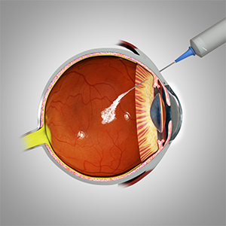
Avastin (Bevacizumab) 2005
Mechanism: VEGF-A binding to reduce vascular leakage.
- CATT (Phase III): Showed non-inferiority to Lucentis for vision stabilization.
- Limitations: Off-label use; requires frequent dosing.
Advantages: Cost-effective alternative.

Slide 19
Lucentis (Ranibizumab) 2006
Mechanism: High-affinity VEGF-A inhibition for reducing edema.
First FDA approved intravitreal medication for WET AMD
MARINA (Phase III): Significant improvement in visual acuity.
ANCHOR (Phase III): Compared favorably with photodynamic therapy.
Advantages: FDA-approved; lower systemic exposure.

Slide 20
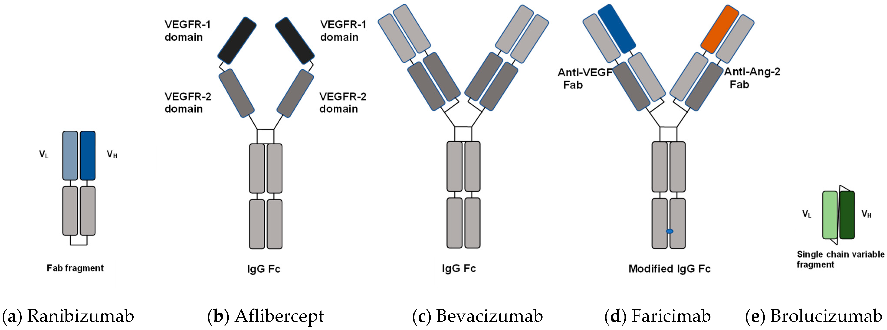

Slide 21
Eylea (Aflibercept) 2011
Mechanism: VEGF-A and PlGF inhibition for prolonged suppression.
VIEW 1 and VIEW 2 (Phase III): Comparable efficacy to Lucentis with fewer injections.
Advantages: Prolonged dosing intervals; reduced injection burden.
Currently most preferred intravitreal VEGF inhibitor in ophthalmology

Slide 22
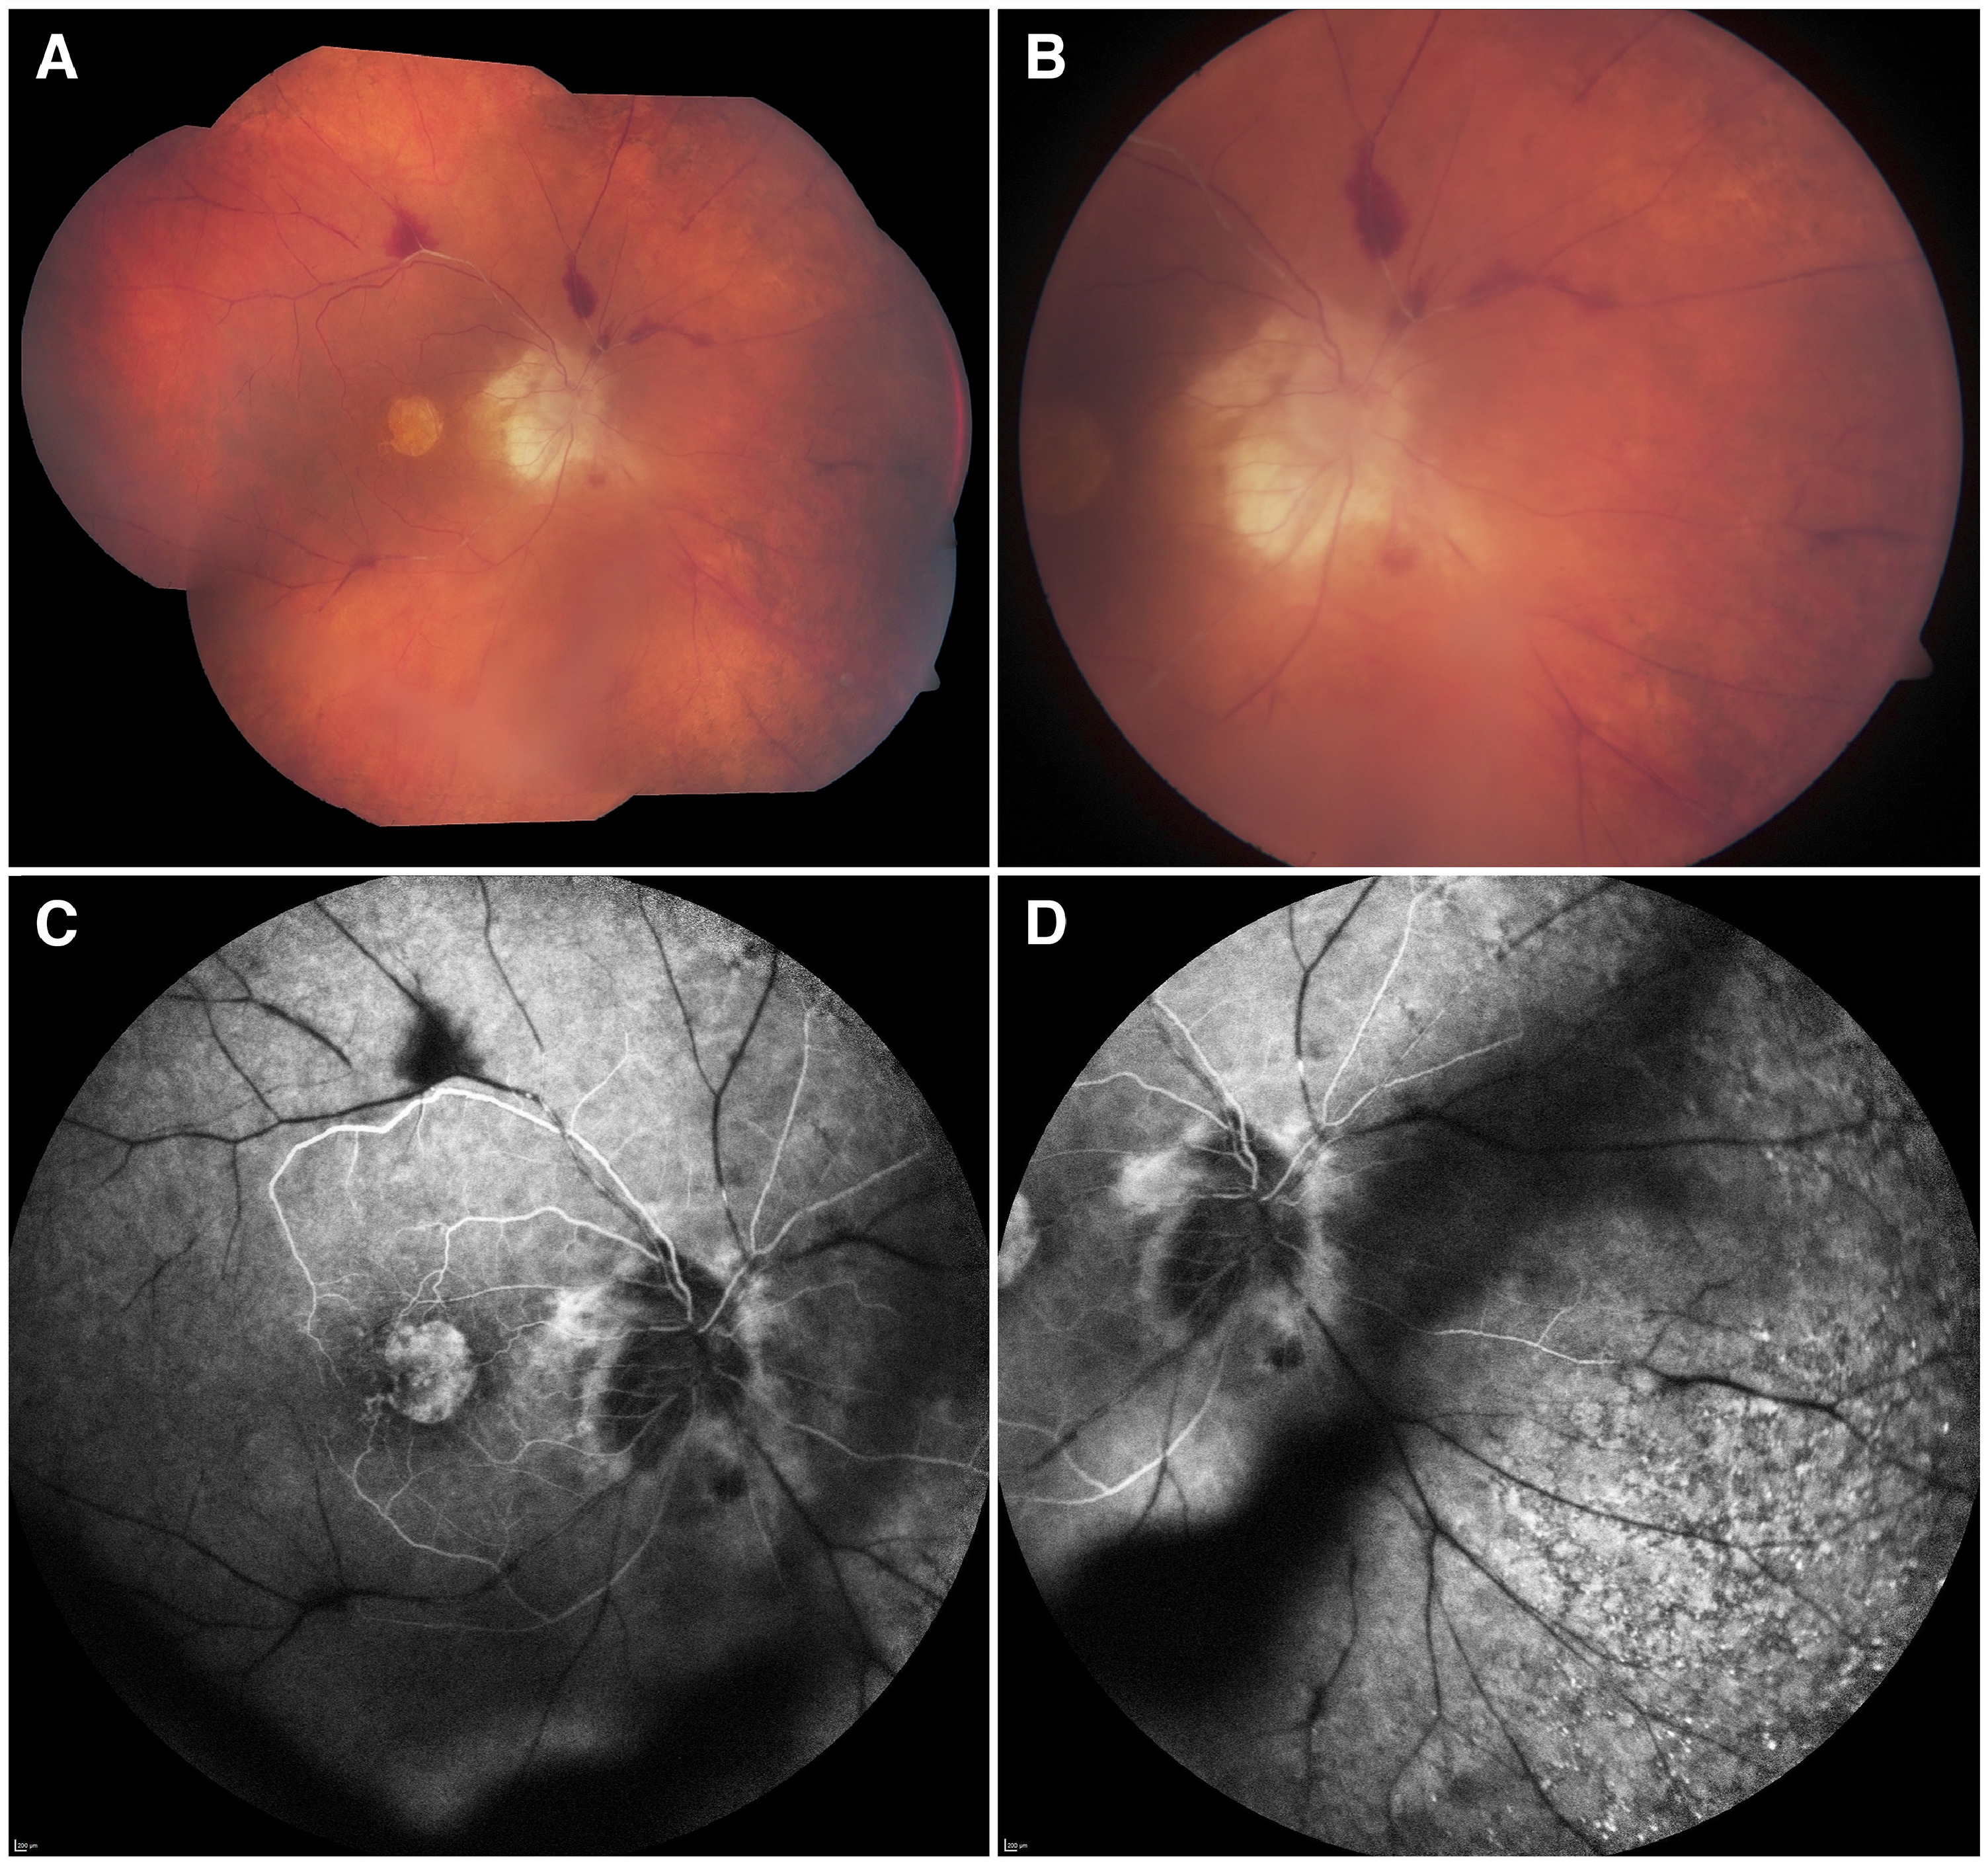
Beovu (Brolucizumab) 2019
Mechanism: Single-chain antibody targeting VEGF-A.
HAWK and HARRIER (Phase III): Prolonged dosing intervals.
Challenges: Associated with inflammation and vasculitis.
Benefits: High potency and better tissue penetration.
Rarely used now due to potential side effects

Slide 23
New and upcoming therapies

Slide 24
Vabysmo (Faricimab) 2022
Mechanism: Dual inhibition of VEGF-A and Ang2.
TENAYA and LUCERNE (Phase III): Extended durability and vessel stability.
Benefits: Effective dual-target approach and longer-lasting outcomes.

Slide 25
Eylea HD 8mg
Higher dose and higher injected volume than Eylea.
Most recent FDA approved medication for Wet AMD
Extended Dosing Intervals: Up to 16 weeks after three initial monthly doses, potentially reducing the frequency of injections for patients.
PULSAR Trial: This pivotal study evaluated EYLEA HD in patients with wet AMD. Results showed that 79% and 77% of patients maintained 12- and 16-week dosing intervals, respectively, through 48 weeks, with vision gains comparable to the standard EYLEA regimen.

Slide 26
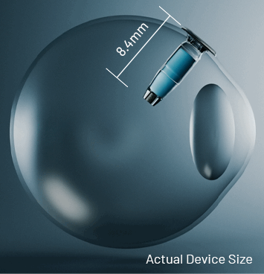
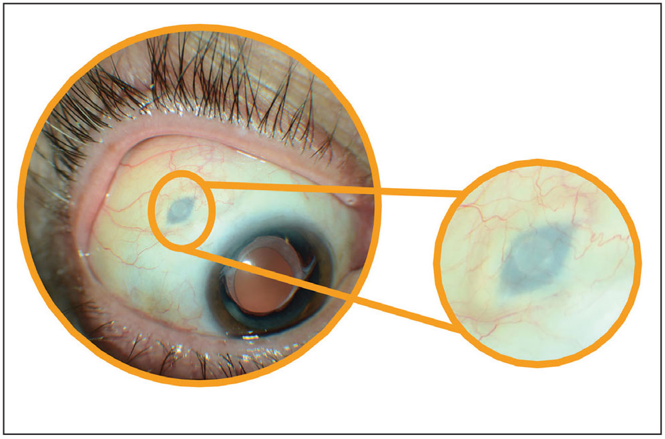
PDS-Susvimo (Ranibizumab Implant)
Mechanism: Refillable implant for ranibizumab (Lucentis) delivery. Q6 months refill
ARCHWAY and PORTAL (Phase III): Effective and reduces treatment burden.
Challenges: Risk of device-related complications.

Slide 27
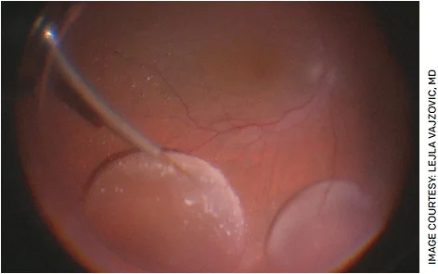
Gene Therapy: ABBV-RGX-314
Mechanism: Continuous VEGF suppression using AAV8 vector.
ATMOSPHERE (Phase II/III): Long-term suppression with reduced injection frequency.
Challenges: Surgical delivery method.
Prospects: Long-term relief with single-dose therapy.

Slide 28
Gene Therapy: Ixo-Vec
Mechanism: Intravitreal delivery of anti-VEGF genes.
OPTIC (Phase I/II): Sustained suppression of VEGF activity.
Advantages: Single-dose therapy potential with minimal follow-ups.
Potentially proinflammatory, patients need steroid treatment

Slide 29
OTX-TKI (AXPAXLI)
Intravitreal implant that aims to treat wet age-related macular degeneration
SOL-1: A superiority study that compares a single AXPAXLI implant to a single aflibercept injection. The primary endpoint is the proportion of subjects who maintain visual acuity at Week 36.
SOL-R: Compares AXPAXLI dosed every 6 months to aflibercept dosed every 8 weeks, also includes a third arm evaluating 8 mg aflibercept dosed every 6 months.

Slide 30
Next Up

Slide 31
Diabetic Macular Edema (DME)
Complication of diabetic retinopathy characterized by the accumulation of fluid in the macula
This fluid buildup occurs due to leakage from damaged retinal capillaries caused by prolonged hyperglycemia and subsequent microvascular damage.

Slide 32
DME
Demographics and Epidemiology:
Prevalence:
  DME is a leading cause of vision loss in diabetic patients worldwide.
  Most common cause of visual loss in NPDR patients
  Approximately 6–10% of diabetics develop DME.
  More common in type 2 diabetes mellitus (T2DM) compared to type 1.
Demographics:
  Affects all ethnicities but may have higher prevalence in African American and Hispanic populations.
  Older age groups and longer diabetes duration are more prone to DME.
  Men may have a slightly higher risk than women.

Slide 33
DME
Chronic Hyperglycemia:
  Leads to microvascular damage in the retina.
  Promotes capillary endothelial dysfunction, pericyte loss, and breakdown of the blood-retinal barrier (BRB).
Key Mechanisms:
  Vascular Leakage: Breakdown of the BRB results in the accumulation of extracellular fluid in the macula.
  Inflammation: Increased levels of inflammatory cytokines (e.g., VEGF, TNF-α) contribute to vessel permeability.
  Retinal Thickening: Fluid accumulation causes retinal thickening and distortion of photoreceptors.
  Ischemia and Hypoxia: Capillary closure and hypoxia upregulate VEGF, which exacerbates permeability and edema.

Slide 34
DME
Systemic Risk Factors:
  Duration of Diabetes: Longer disease duration increases risk.
  Poor Glycemic Control (HbA1c): Higher levels are strongly associated with DME.
  Hypertension and Dyslipidemia: Elevated blood pressure and cholesterol.
Ocular Risk Factors:
  Diabetic Retinopathy Severity: More advanced retinopathy correlates with higher DME incidence.
Lifestyle Factors:
  Obesity, Smoking, and Sedentary Lifestyle are associated with increased risk due to systemic vascular effects.

Slide 35
DME
Clinical Implications
DME often presents bilaterally, although severity may differ between eyes.
Screening and early detection through regular retinal exams (including optical coherence tomography [OCT] and fluorescein angiography) are critical for preventing vision loss.
Prompt intervention, including anti-VEGF agents, corticosteroids , and laser photocoagulation, has shown significant improvement in outcomes.
Several new therapies in development

Slide 36
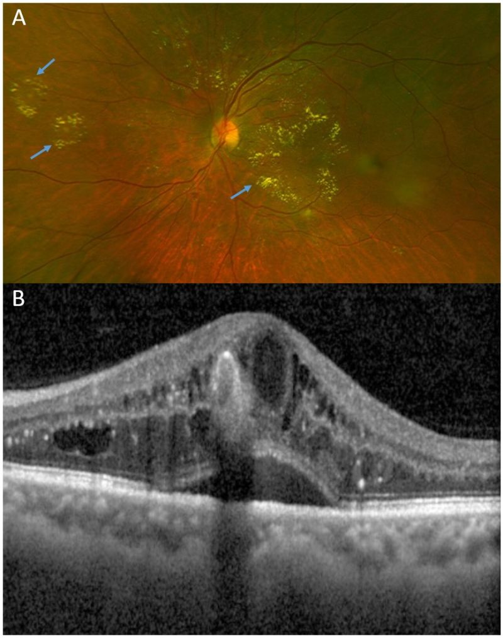

Slide 37
Avastin (Bevacizumab) 2005
Mechanism: VEGF-A binding to reduce vascular leakage.
RCR Protocol T: Effective for visual improvement- Similar to Lucentis, slightly inferior to Eylea in patients with Va worse than 20/40
Limitations: Off-label use; requires frequent dosing.
Advantages: Cost-effective alternative.
Most used medication for DME

Slide 38
Lucentis (Ranibizumab) 2006
Mechanism: High-affinity VEGF-A inhibition for reducing edema.
RISE and RIDE (Phase III): Effective in restoring visual function.
Advantages: FDA-approved; lower systemic exposure.

Slide 39
Eylea (Aflibercept) 2011
Mechanism: VEGF-A and PlGF inhibition for prolonged suppression.
VIVID and VISTA (Phase III): Prolonged suppression of edema and neovascularization
Advantages: Prolonged dosing intervals; reduced injection burden.
Currently most preferred intravitreal VEGF inhibitor in ophthalmology

Slide 40
Vabysmo (Faricimab) 2022
Mechanism: Dual inhibition of VEGF-A and Ang2, 2 different molecules.
YOSEMITE and RHINE (Phase III): Effective in reducing edema.
Benefits: Effective dual-target approach and longer-lasting outcomes.

Slide 41
Eylea HD 8mg
Higher concentration and higher injected volume than Eylea.
Extended Dosing Intervals: Up to 16 weeks after three initial monthly doses, potentially reducing the frequency of injections for patients.
PHOTON Trial: This pivotal study evaluated EYLEA HD in patients with DME. Results showed that 89% and 84% of patients maintained 12- and 16-week dosing intervals, respectively, through 48 weeks, with vision gains comparable to the standard EYLEA regimen.

Slide 42
Triescence (Kenalog)
Used for DME, CME, MEFRVO and ocular inflammation
Commonly used due to relative affordability
On backorder until recently

Slide 43
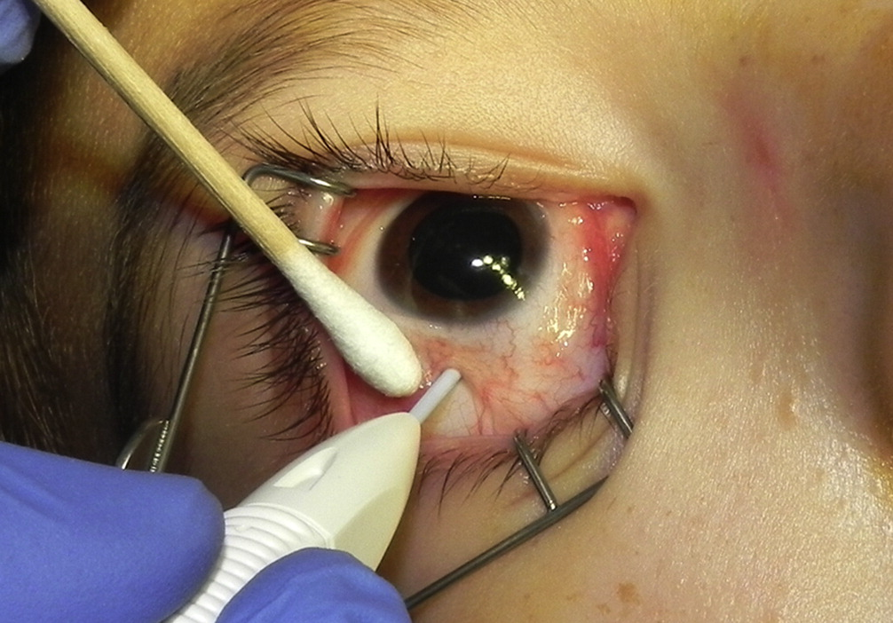
Ozurdex (Dexamethasone Implant)
Mechanism: Gradual corticosteroid release to suppress inflammation and edema.
MEAD (Phase III): Significant reduction in edema.
Challenges: Risk of cataracts and intraocular pressure increase.

Slide 44
Iluvien (Fluocinolone Implant)
Mechanism: Continuous low-dose corticosteroid release.
FAME (Phase III): Effective reduction in edema for up to 36 months.
Advantages: Long-term solution but requires careful monitoring.
Considerations: $$, overall long duration but perceived to not be as strong as other options, commitment to long therapeutic effect.

Slide 45
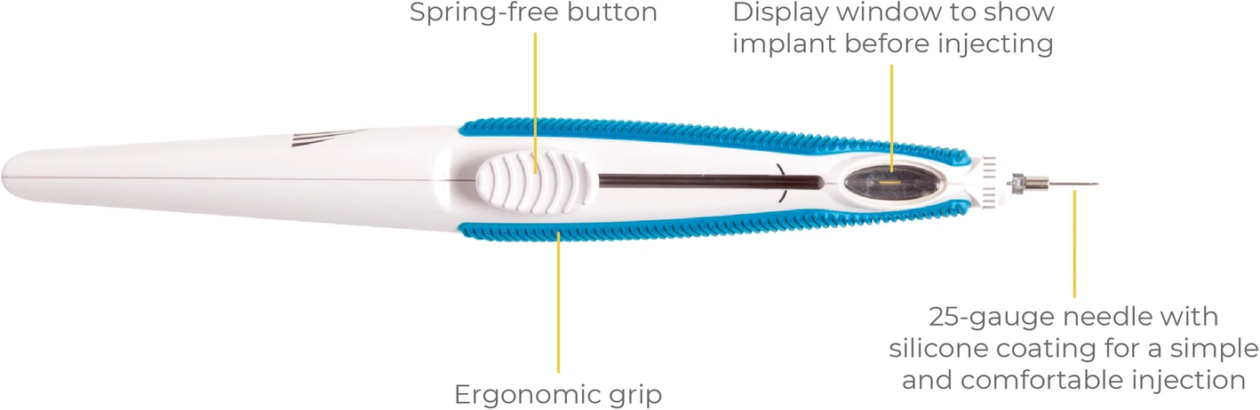

Slide 46
Eyedrops?

Slide 47
OCS-01 (Oculis):
OPTIREACH® technology to enhance drug delivery to the retina.
DIAMOND trial, demonstrated a significant increase in visual acuity and a reduction in macular edema.
Stage 2, comprising two 52-week parallel Phase 3 clinical trials, DIAMOND-1 and DIAMOND-2, just finished enrolling participants.

Slide 48
Tivozanib Eye Drops
Small-molecule vascular endothelial growth factor receptor (VEGFR) and tyrosine kinase inhibitor.
Phase 2 clinical trial has been initiated to evaluate the efficacy and safety of tivozanib eye drops in patients with DME.

Slide 49
EXN407 (Exonate):
This eye drop is designed to inhibit serine/threonine-protein kinase SRPK1, reducing pathological vascular leakage.
Phase Ib/IIa clinical trial assessed the safety, tolerability, and biological response of EXN407 monotherapy in treatment-naïve patients with mild to moderate non-proliferative diabetic retinopathy and mild DME.
The study met its pre-specified endpoints, indicating potential as a non-invasive therapy option.

Slide 50
Dexamethasone Nanoparticle Eye Drops:
Aims to deliver corticosteroids effectively to the retina via a non-invasive route.
A clinical trial is underway to evaluate the safety and efficacy of dexamethasone nanoparticle eye drops in patients with DME.

Slide 51
Macular edema following RVO (MEfRVO)
Prevalence:
  RVO affects ~0.7–1.6% of adults globally.
  BRVO (~80%) is more common than CRVO (~20%).
Risk Factors:
  Systemic: Hypertension, diabetes mellitus, hyperlipidemia, cardiovascular disease.
  Ocular: Glaucoma, hypercoagulable states.
  Demographics: More common in individuals >50 years; slightly higher incidence in males.

Slide 52
Macular edema following RVO (MEfRVO)
Primary Event: Venous occlusion due to compression by adjacent arterioles at arteriovenous crossings, leading to: Venous Stasis and Hypertension → Increased vascular permeability.
Capillary Damage → Ischemia and breakdown of the blood-retinal barrier.
Inflammation → Release of VEGF (vascular endothelial growth factor) and inflammatory cytokines.
Macular Edema Formation → Fluid accumulation in the macula due to leakage from damaged capillaries.

Slide 53
Macular edema following RVO (MEfRVO)
Anti-VEGF Agents (First-line):
  Drugs: Ranibizumab, Aflibercept, Bevacizumab (off-label), Aflibercept 8mg in clinical trials
  Mechanism: Inhibits VEGF, reducing vascular permeability and edema.
  Dosing: Monthly injections initially, then treat-and-extend approach.

Slide 54
Macular edema following RVO (MEfRVO)
Corticosteroids:
  Drugs: Dexamethasone intravitreal implant (Ozurdex), Triamcinolone.
  Mechanism: Anti-inflammatory; suppress VEGF and cytokines.
  Considerations: Risk of increased IOP and cataract formation.

Slide 55
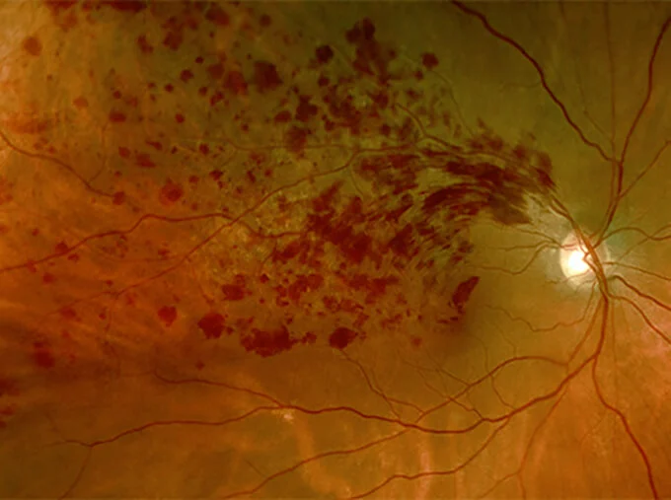

Slide 56
Dry AMD (GA)
Geographic Atrophy (GA) is an advanced form of dry age-related macular degeneration (AMD) characterized by progressive, irreversible degeneration of the retinal pigment epithelium (RPE) and photoreceptors in the macula.
Central vision loss.
Unlike wet AMD, GA does not involve choroidal neovascularization (abnormal blood vessel growth).

Slide 57
GA
Demographics and Epidemiology:
Prevalence:
  AMD affects approximately 196 million people globally; this number is expected to rise to 288 million by 2040.
  GA accounts for 20% of late-stage AMD cases.
Age:
  Primarily affects individuals 60 years and older, with prevalence increasing with age.
Gender:
  Slightly more common in women due to their longer life expectancy.
Race/Ethnicity:
  Most common in Caucasians, likely due to genetic and environmental factors.

Slide 58
GA
Risk Factors:
  Genetics (e.g., CFH, ARMS2/HTRA1 variants)
  Smoking (2–3 times higher risk)
  Hypertension and cardiovascular disease
  Obesity
  Nutritional deficiencies (low antioxidants and zinc)
  UV light exposure

Slide 59
GA
RPE and Photoreceptor Degeneration:
  Begins with dysfunction and apoptosis of the retinal pigment epithelium (RPE), critical for photoreceptor survival and waste removal.
  Loss of RPE leads to secondary photoreceptor atrophy and choriocapillaris loss.
Drusen Accumulation:
  Drusen deposits form between the RPE and Bruch’s membrane, interfering with nutrient and waste exchange.
  Over time, drusen contribute to oxidative stress, inflammation, and complement system activation.
Complement System Dysregulation:
  Genetic mutations, especially in complement factor H (CFH), lead to excessive immune activation and chronic inflammation, accelerating RPE damage.

Slide 60
GA
Visual Symptoms:
  Gradual central vision loss with relative sparing of peripheral vision.
  Scotomas (blind spots) develop in areas of atrophy.
  Difficulty with reading, recognizing faces, and low-light adaptation.
Progression Rates:
  Average growth rate of GA lesions: 1.78–2.64 mm²/year.
  Larger baseline lesions and multifocal patterns progress more rapidly.
Bilateral Involvement:
  ~40–50% of patients develop GA in both eyes over time.

Slide 61
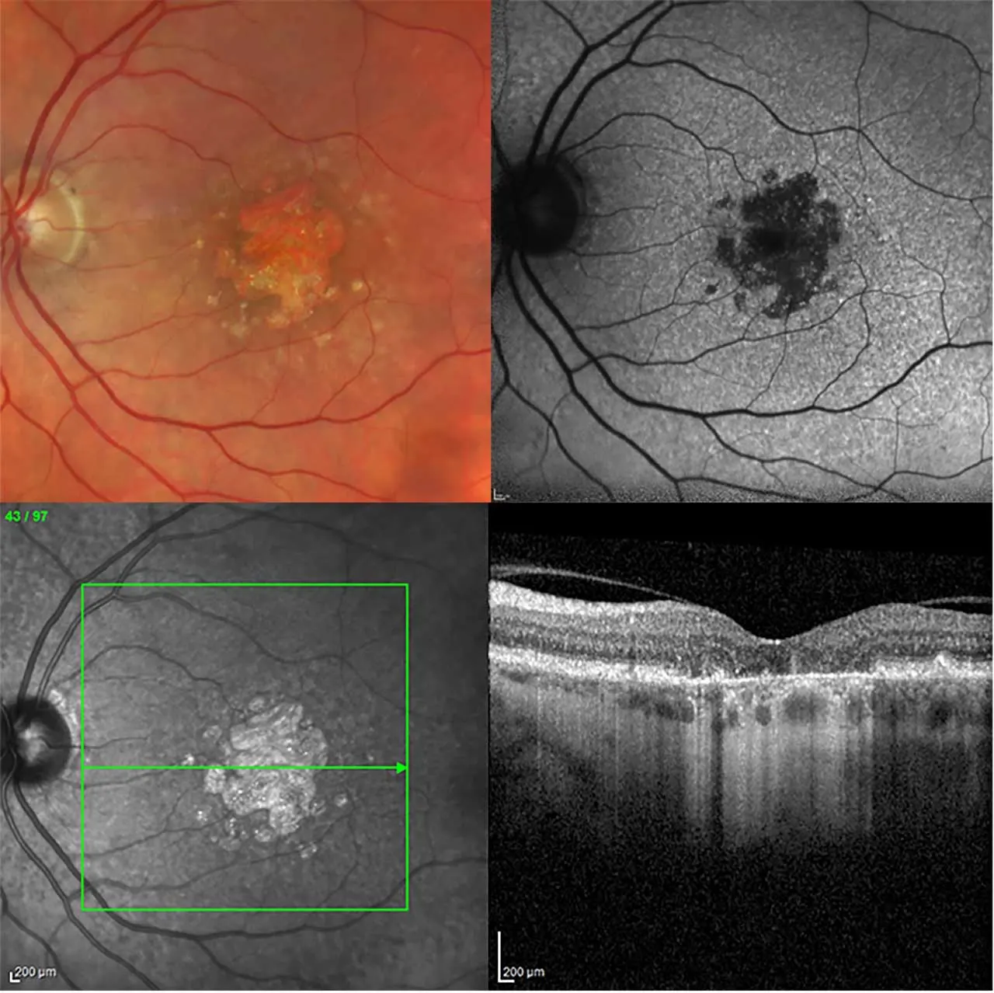
GA
5-Year Risk of Progression:
Early AMD to GA: 12–20%.
Intermediate AMD to GA: 25–30%.
Vision Impairment:
GA contributes to 20% of legal blindness cases in industrialized nations.

Slide 62
Syfovre (Pegcetacoplan). (2023)
Mechanism: C3 complement inhibitor to slow GA progression.
DERBY and OAKS (Phase III): Slowed lesion growth and protected retinal cells.
Advantages: Preserves vision with regular dosing, q2m(21%) or q1m(31%).
Recent data shows decreased rate of progression up to 40% at 3 years
Controversies: Few cases of hemorrhagic retinal vasculitis reported
Large injected volume 0.1ml, thick substance.

Slide 63
Izervay (Avacincaptad pegol) 2023
Mechanism: blocks complement cascade at C5 to block cell death.
Phase III Trials: Reduced progression of retinal atrophy (35%).
Advantages: Preserves retinal structure and reduces inflammation, no significant reported cases of severe ocular inflammation.
Controversies: Q1month dosing, no FDA approval past 1 year of treatment, large injection volume 0.1ml

Slide 64
Elamipretide
AMD is associated with mitochondrial dysfunction and oxidative stress in retinal pigment epithelial (RPE) cells and photoreceptors.
Elamipretide’s mechanism of action—mitochondrial stabilization and reduction of oxidative stress
Protect retinal cells from damage.
Slow the progression of atrophy.
Improve mitochondrial energy production in RPE cells.
Clinical Studies in AMD (Stealth)
SQ daily injection
Improved mitochondrial function in retinal cells.
Reduced oxidative damage.
Slower progression of cellular atrophy in the retina.

Slide 65
AVD-104
Intravitreal glycan-coated nanoparticle designed to inhibit retinal macrophage activity, as well as inhibiting complement cascade amplification.
SIGLEC trial, a double-masked, randomized, controlled study
Currently underway and aims to enroll approximately 300 patients comparing avacincaptad pegol (Izervay)
Results second half 2015

Slide 66
Biosimilars
Biologic drugs that are highly similar, not necessarily the same, as existing FDA-approved biologic therapies, known as reference products.
  Cost Savings: Typically, biosimilars are more affordable, increasing access for patients.
  Comparable Efficacy: Clinical trials have demonstrated similar effectiveness in reducing fluid accumulation and improving vision.
  Regulatory Assurance: FDA and other regulatory bodies ensure strict standards for safety, purity, and potency.

Slide 67
Biosimilars
Byooviz (ranibizumab-nuna): Approved by the FDA in September 2021 as a biosimilar to Lucentis.
Cimerli (ranibizumab-eqrn): Approved in 2022, another biosimilar to Lucentis with interchangeable status.
Pavblu (Aflibercept-ayyh) Approved in 2024, biosimilar to Eylea

Slide 68
Thanks for your attention!

Slide 69
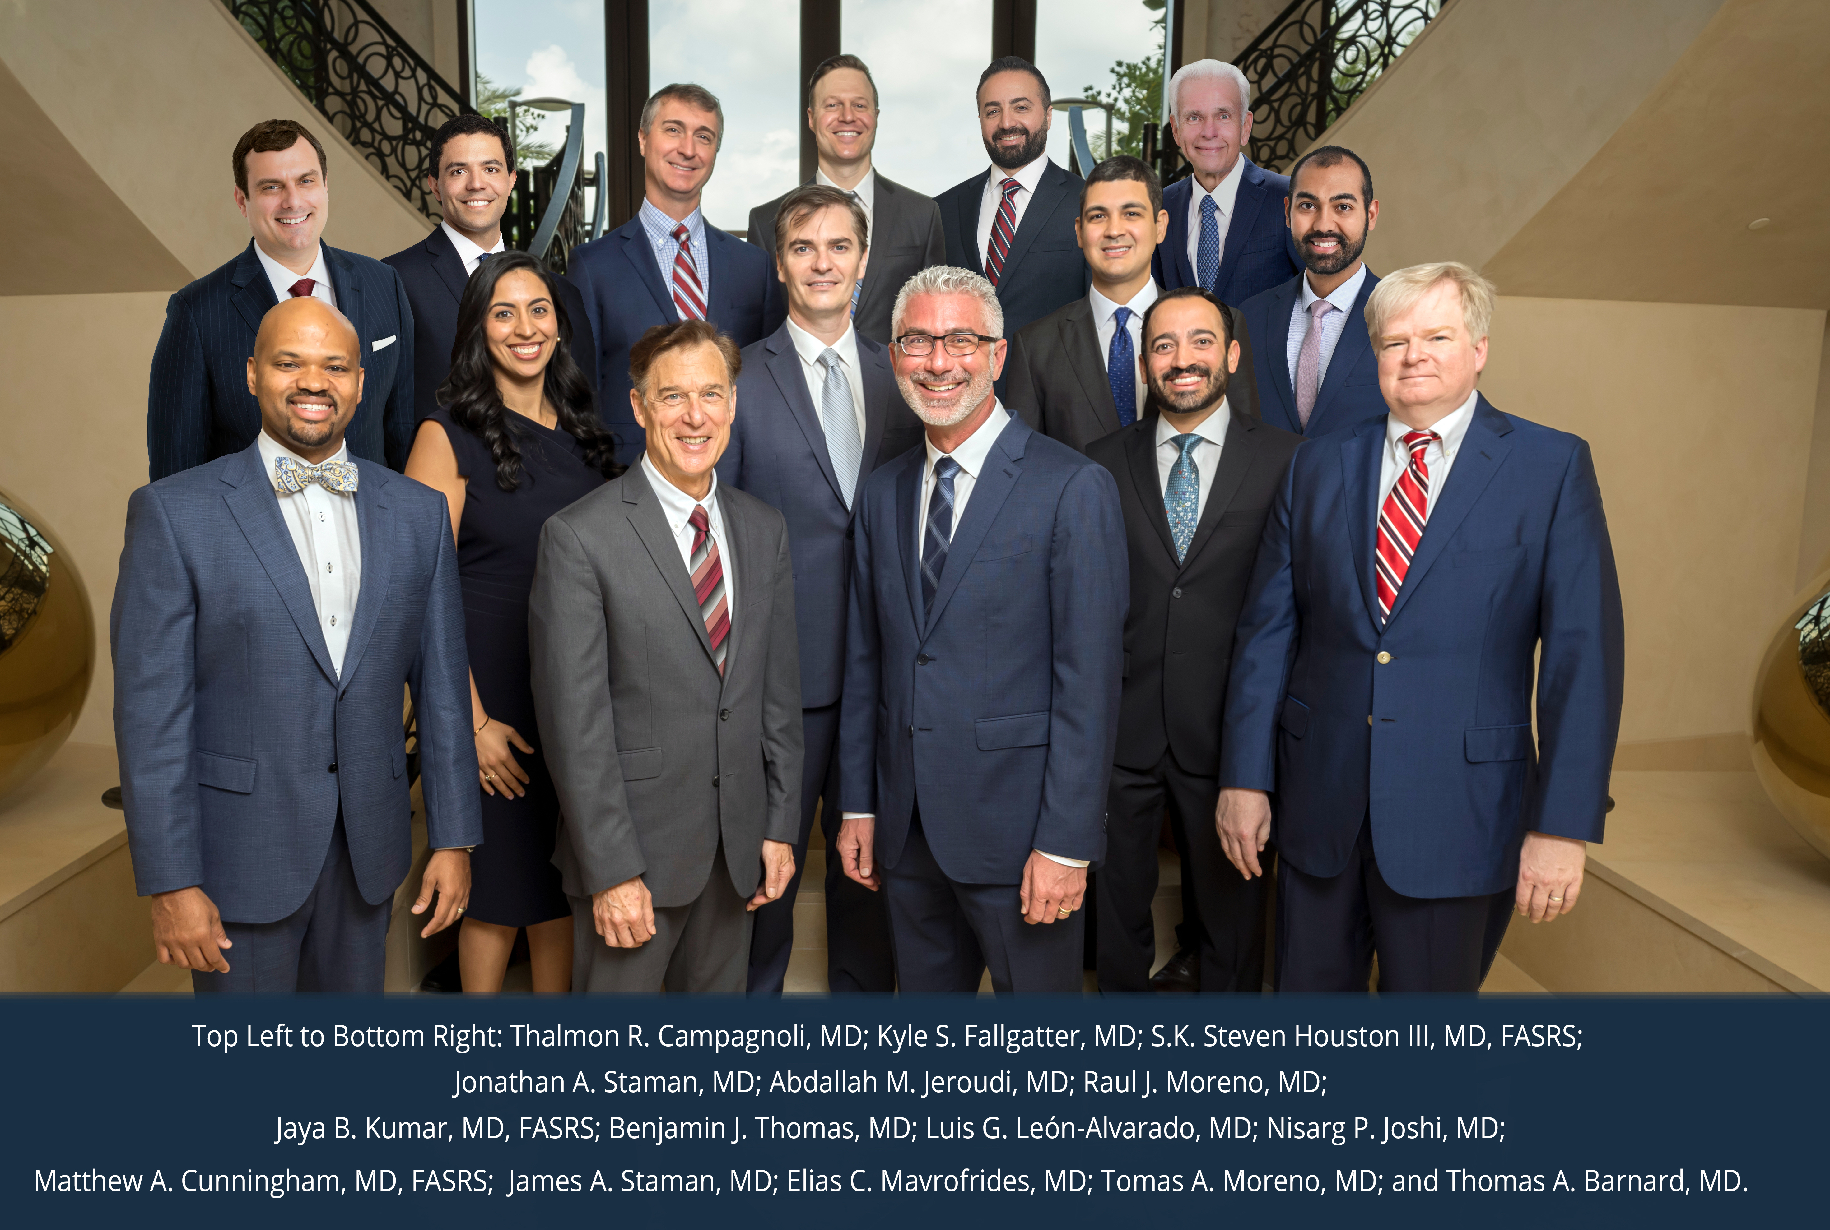
Thank you for the great opportunity to speak with you this evening!
Florida Retina Institute truly appreciates your time and are grateful for the partnership we share. Looking forward to our continued collaboration.
Confidential © Florida Retina Institute, October 24, 2024

